Slide 1
Notes:
This is how grain drying occurs: water is evaporated from the grain by the edition of heat energy and airflow. The heat required depends somewhat on temperature, but is roughly 1,000 BTUs per pound of water evaporated. The airflow simply carries the evaporated water away from the grain. There are no known ways to bypass these principles, but we can make the best of these principles and the energy we supply.

Slide 2
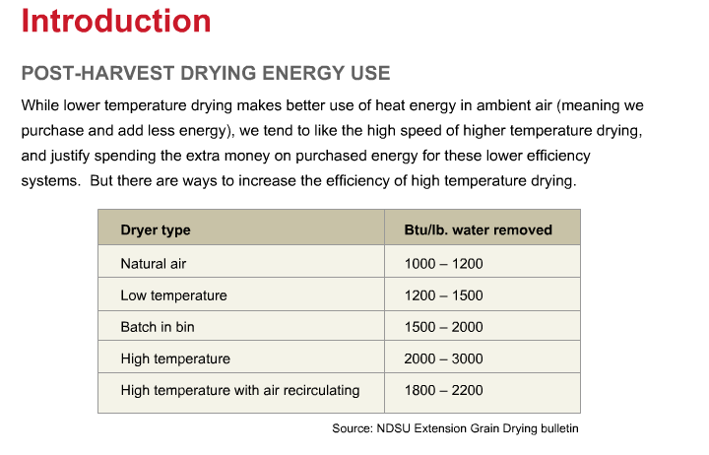
Notes:
While lower temperature drying makes better use of heat energy and ambient air, meaning we purchase and add less energy, we tend to like the high speed of higher temperature drying, and justify spending the extra money on purchased energy for these lower-efficiency systems. But there are ways to increase the energy efficiency of high-temperature drying.

Slide 3
Notes:
Dryeration increases energy efficiency by 15 to 30 percent compared to high temperature drying with immediate cooling. The drying rate (that is, bushels per hour) is also increased by 50 to 70 percent compared to high-temperature drying with cooling in the dryer. Grain quality is also improved, with reduced stress-cracking of kernels, reduced kernel brittleness and improved grain millability.";

Slide 4
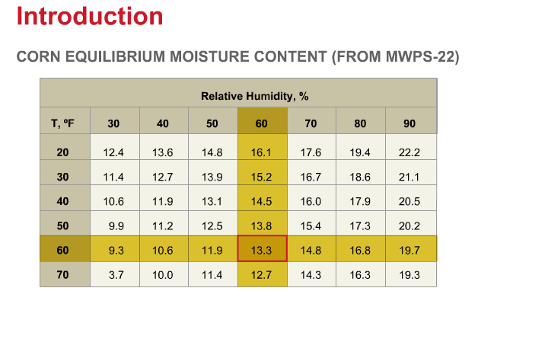
Notes:
The drying potential of air follows the concept of equilibrium moisture content. For example, air at 60 degrees Fahrenheit and 60 percent relative humidity will dry corn to a moisture content of about 13.3 percent, but it takes a long time to evaporate the moisture with that low temperature.

Slide 5
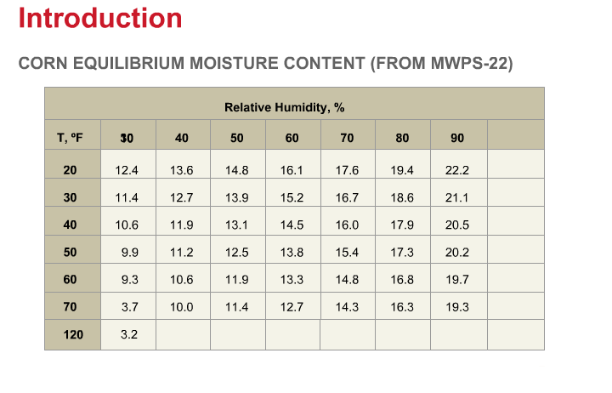
Notes:
To speed up the process, we can heat that same air to 120 degrees Fahrenheit, but, in so doing, we lower the relative humidity to about 10 percent. If we let the corn reach equilibrium with this air, the resulting moisture content would be 3.2 percent, rather than 13.3 percent. So, in high-temperature drying, we stop the process before the grain has time to reach equilibrium with the heated air and before the airflow has reached saturation. This creates inefficiency in the drying process.

Slide 6
Notes:
Dryeration restores some efficiency to the high-temperature drying process. Drying is halted when the grain is still 2 to 3 percentage points above the desired finished grain moisture. Hot grain is moved to a separate bin to steep for at least 4 and, preferably, 6 to 12 hours before cooling. Additional moisture is removed during the cooling process, and then the cooled grain is moved to storage.

Slide 7
Notes:
Represented with animation, it looks like this. Grain starts out, relatively speaking, cold and wet. The wet grain is dried quickly with high-temperature air. Moisture is removed mostly from the outer portion of the kernel, with the center still being wetter. The hot grain is allowed to steep, giving time for the moisture in the kernel to equalize again. After steeping, the grain is cooled and some additional moisture near the outside of the kernel is removed during the cooling process.

Slide 8
Notes:
Compared to high-speed, high-temperature drying immediate cooling in the dryer, Dryeration provides reduction in heating fuel use because drying is stopped sooner. Even though there is a separate cooling fan, stopping the drying sooner and not cooling in the dryer results in reduction in fan electric use as well.";

Slide 9
Notes:
Using energy figures from the previous slide and energy costs of a dollar and 30 cents per gallon of LP gas and twelve cents per kilowatt hour of electricity, here are per bushel costs for gas, electricity and total energy for removing 10 points of moisture. You see that dryeration reduces the total energy costs, mostly through reduced heating fuel. You can compare systems with your own fuel costs using the spread sheets from ISU’s Ag Decision Maker, mentioned in the resources at the end of this presentation.

Slide 10
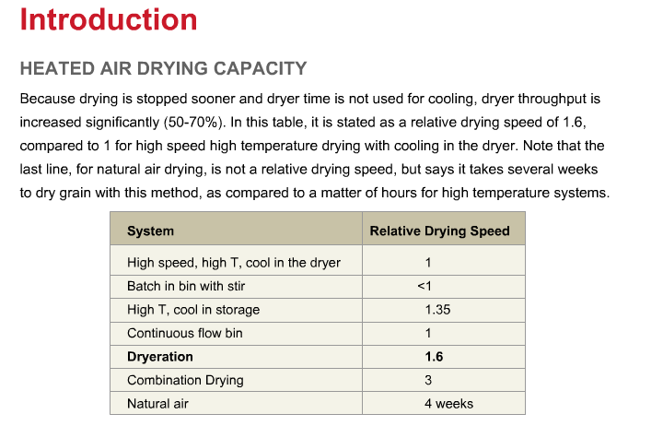
Notes:
Because drying is stopped sooner and dryer time is not used for cooling, dryer throughput is increased significantly: 50 to 70 percent increase in capacity. You see that, in this table, as a relative drying speed of 1.6, compared to 1 for high-speed, high-temperature drying with cooling in the dryer. Note that the last line in this table for natural air drying is not a relative drying speed, but simply says it takes several weeks to dry grain with this method, as compared to a matter of hours for high-temperature systems.

Slide 11
Notes:
Some equipment modification is need for dryeration. The high-temperature dryer performs the majority of the grain drying. A separate bin or bins are needed for steeping and cooling the grain. Extra conveyers are needed to move the hot grain to the cooling bins and from the cooling bins to storage, and controls are needed to manage the cooling fans and conveyers.

Slide 12
Notes:
The 2 cooling bins are sized to each hold one day’s drying capacity. Remember, system capacity that is drying bushels per hour, will increase with dryeration. Use full aeration floors and sweep augers in the cooling bins. The hot grain will lead to condensation on the inside of the cooling bins during steeping. Select bins and equipment that can manage this condensation. It’s also wise, when planning a system, to plan ahead for growth and expansion of the total drying system.

Slide 13
Notes:
Cooling time of about 12 hours works well with a 2-bin cooling system. Cooling rate is determined by air-flow. Cooling air flow rates of 1 half to one and a half cubic feet per minute per bushel can be used. A good target is 1 CFM per bushel. An airflow rate of around 1 CFM per bushel will achieve a 12-hour cooling cycle. This allows for one cooling bin to be loading and steeping all day while the other cooling bin is cooling and unloading. Fan sizing programs or tables can be used to accurately estimate fan horsepower and airflow rate for different bin configurations. References at the end of the presentation provide more detail.

Slide 14
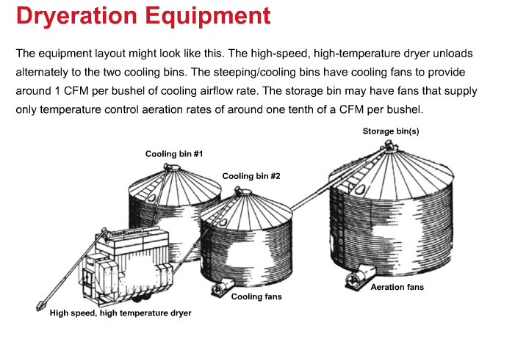
Notes:
The equipment layout might look like this. The high-speed, high-temperature dryer unloads alternately to the two cooling bins. The steeping cooling bins have are cooling fans to provide around 1 CFM per bushel of cooling airflow rate. The storage bin may have fans that supply only temperature control aeration rates of around one tenth of a CFM per bushel.

Slide 15
Notes:
As an example, let’s start with a dryer with a current capacity of 10,000 bushels per day. Allowing for an increase in drying capacity of 60 percent, we should allow for a dryeration capacity of around 16,000 bushels per day. Using two cooling bins, we will size each cooling bin for one day’s capacity, or 16,000 bushels. In order to cool in about 12 hours, we’ll need fans on each cooling bin that can deliver around 16,000 CFM through the 16,000 bushels. We should also consider if planning now for system expansion or a bigger dryer would be wise.

Slide 16
Notes:
Summarizing management for dryeration systems, stop the dryer and transfer the hot grain 2 to 3 percentage points above the desired moisture content. Allow the hot grain to steep at least 4, and preferably 6 to 12 hours, then cool the grain and transfer it to storage. Check the finished, that is, cooled, moisture content, and adjust the drying time as needed.

Slide 17
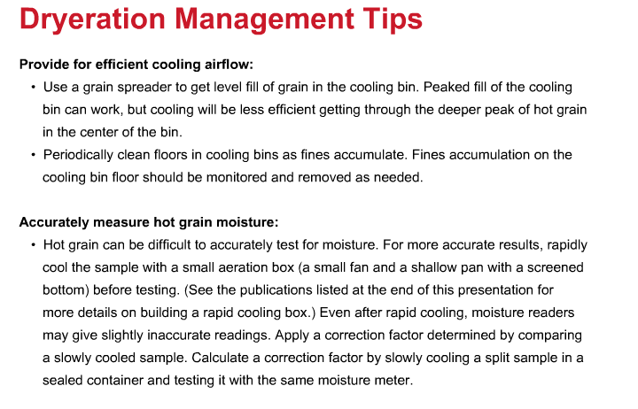
Notes:
Peaked fill of the cooling bin can work, but cooling will be less efficient getting through the deeper peak of hot grain in the center of the bin. Use a grain spreader to get level fill of grain in the cooling bin. Fines accumulation on the cooling bin floor should be monitored and removed as needed. Hot grain can be difficult to accurately test for moisture. In a more accurate test, by cooling it quickly using a small fan and a shallow pan with a screened bottom. See the publications listed at the end of this presentation for more details on building a rapid cooling box. Even after rapid cooling, moisture meters may give slightly inaccurate readings. Calculate a correction factor by slowly cooling a split sample in a sealed container and testing it with the same moisture meter.

Slide 18
Notes:
Hot, moist air from the steeping and cooling process can form considerable condensation on the upper walls and the roof of the cooling bin and inside downspouts or other connected grain-handling equipment. Provide a drip gap between the roof and sidewall to allow roof condensation to drip outside the bin. Power-ventilating the head space above the grain and the cooling bin during the steeping process may help. Condensation will be greater during cooler parts of the day and cooler parts of the drying season. Timing the cooling cycle to occur during warmer parts of the day can help. Downspouts from grain legs can act like a chimney for warm, moist air. Consider equipping them with shutoff valves and vents to prevent hot, moist air from entering during the steeping and cooling cycle. Sidewall condensation is difficult to control, and generally will be mixed adequately during the unloading process to prevent problems.

Slide 19
Notes:
Batch dryers are generally easy to convert to dryeration. Just omit the cooling cycle. Continuous flow dryers will require more extensive modification to eliminate the dryer cooling cycle. Always consult the dryer manufacturer for advice and guidance on modifying continuous-flow dryers for dryeration. Adding a heater unit to the cooling airflow may allow for additional drying capacity while eliminating the cooling section. Removing the divider between the drying and cooling section may allow the existing drying fan and heater to heat both sections, but airflow and heating capacity will have to be checked. Continuous flow dryers with integrated heat recovery from the cooling cycle may not be good candidates for conversion to dryeration, but these systems are already capturing improvements in energy efficiency.

Slide 20
Notes:
Looking at dryeration references, the ISU extension publication is a brief overview of energy savings with dryeration and combination of high-temperature, low-temperature drying. The Minnesota extension website is an excellent summary of dryeration and in-storage cooling. The North Dakota State Extension bulletin is an old 1983 print version of dryeration and in-storage cooling principles. While it’s old, it is still an excellent background piece.

Slide 21
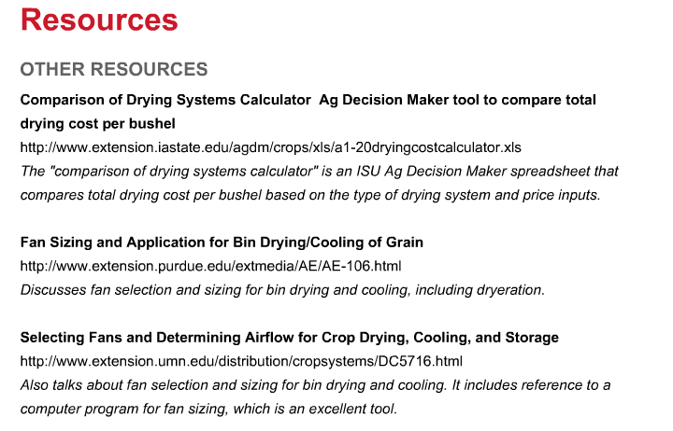
Notes:
In other resources, the comparison of drying systems calculator is an ISU Ag Decision Maker spreadsheet that compares total drying cost per bushel based on the type of drying system and price inputs. The Purdue extension bulletin talks about fan selection and sizing for bin drying and cooling, including dryeration. The Minnesota extension bulletin also talks about fan selection and sizing for bin drying and cooling. It includes reference to a computer program for fan sizing, which is an excellent tool.

