Slide 1
WELCOME!
VM 101 | Rendered Ingredients
Dr. Cassie Jones
Assistant Professor of Feed Technology
Kansas State University
Manhattan, KS
jonesc@ksu.edu

Slide 2
Lesson Objectives
By the end of the lesson, participants will be able to:
Identify rendered ingredients
List the component steps of the rendering process prior to receipt at the feed mill
Identify specialized equipment used to process rendered ingredients
List hazards associated with rendered ingredients

Slide 3
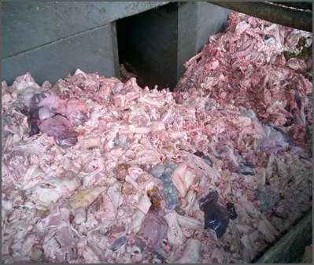
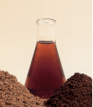
Importance & Relevance
Utilizing otherwise unused foodstuffs & by-products
48 billion lbs. annually
5% restaurant grease
4% grocery/butcher waste
91% slaughter by-products
Average chemical composition of raw
40 – 60% water
20 – 30 % protein
20 – 30% fat
Turning Waste Into Quality Ingredients
Slide # 3
Notes:
Photo of tissue and ingredients: NRA/Meeker

Slide 4
Common Rendered Ingredients
Notes:
Common Rendered Ingredients pie charts: C. Jones

Slide 5
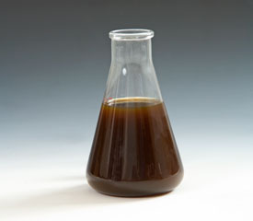
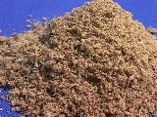
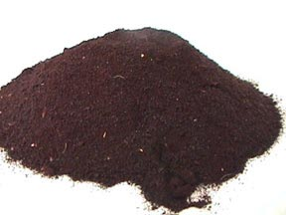
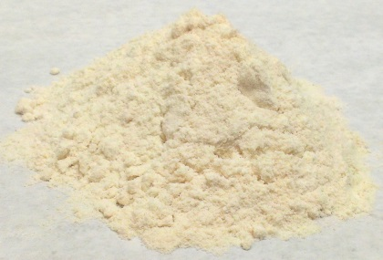
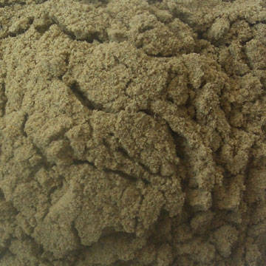
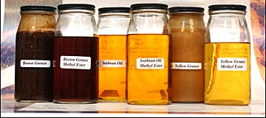
Common Rendered Ingredients
Feather Meal
Poultry Meal
Poultry Fat
Meat & Bone Meal
Blood Meal
Spray-Dried Animal Plasma
Fish Meal
Tallow
Choice White Grease
Yellow Grease
Notes:
Photos of meals and grease: Iowa State University

Slide 6
Quality Concerns
Protein content of Meat and Bone Meal: Pearl, 2004
Slide # 6
Notes:
Pearl, G. 2004. Tech Topics: Meat and bone meal usage in modern swine diets. Pages 50-53 in Render. The National Renderers Association, Camino, CA.

Slide 7
Quality Concerns (cont.)
Moisture (%) | Pro-oxidant, diluent
Impurities | Pro-oxidant
Unsaponifiables | Sterols, pigments
Free Fatty Acids | Rancidity
Peroxide Value | Primary oxidation
Anisidine Value | Secondary oxidation
Iodine Value | Double bonds
Color | Processing damage
Active Oxygen Method | Retard oxidation

Slide 8
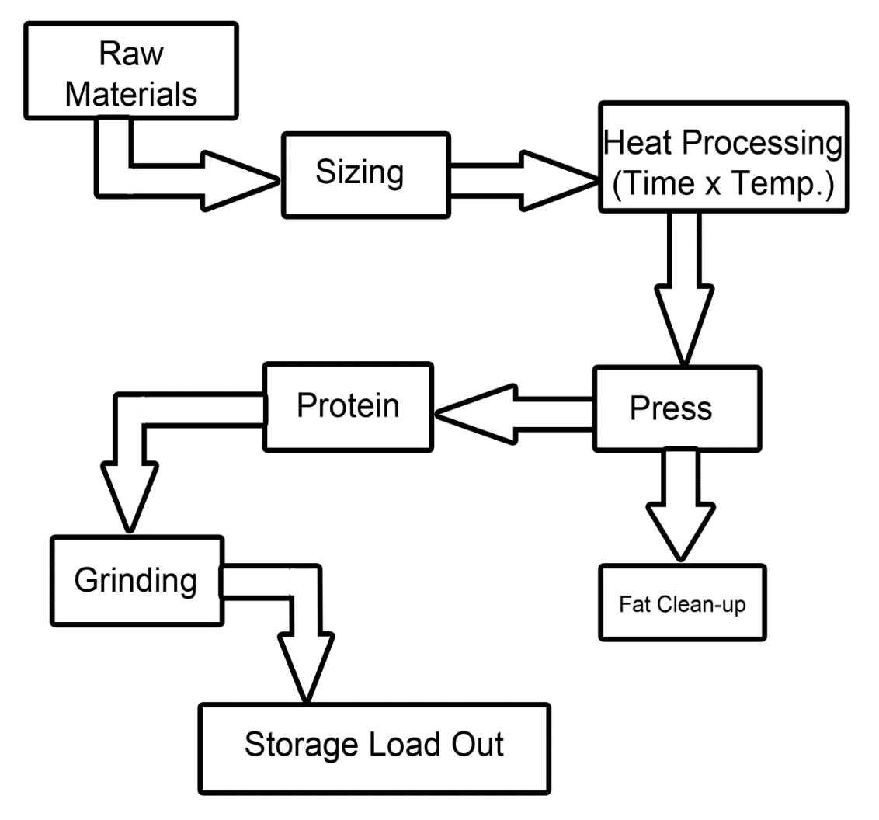
Rendering Process
Wet Rendering Process
Raw material exposed to hot water (180-205°F)
Water later evaporated
No longer used in U.S.
Notes:
Graphic of rendering process: KSU

Slide 9
Rendering Process (cont.)
Dry Rendering Process
Raw material dehydrated in batch or continuous cookers at 240-290°F
Total cooking time: 2-3 hours
250°F and 2.8 bar, 45 minutes
275°F and 2 bar, 30 minutes
Water drained, solids pressed in screw press to extract fat

Slide 10
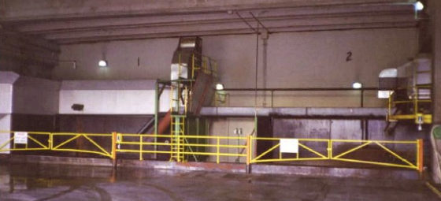
Rendering Process (cont.)
Receiving and Sizing
Goal: Receive products and sort into similar sizes
Important for cooking
Process: Sift and grind products
Sizing Process
Notes:
Photo of sizing process: NRA/Meeker

Slide 11
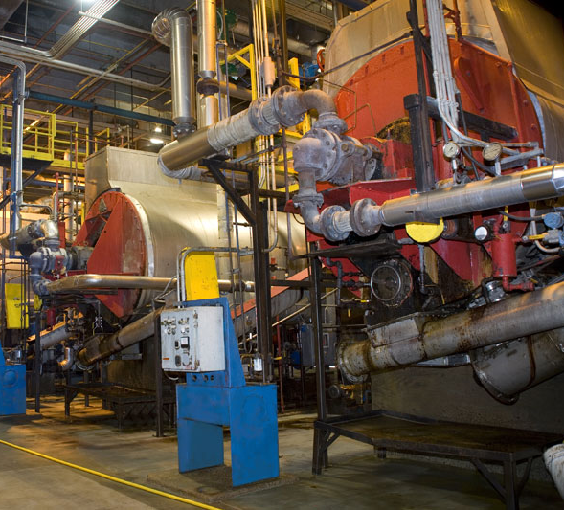
Rendering Process (cont.)
Heat Processing
Goals:
Destroy pathogens
Melt fat to facilitate separation from bone and protein
Remove water
Heat Processing
Notes:
Photo of heat processing: NRA/Meeker

Slide 12
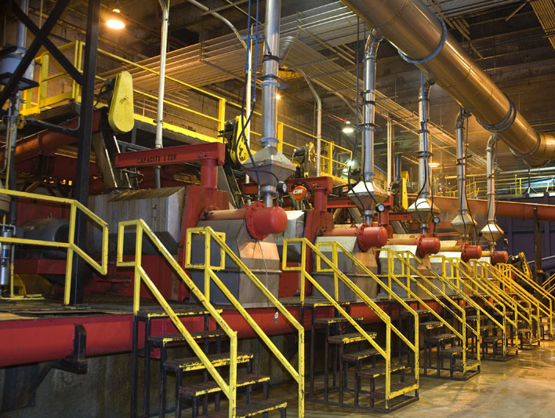
Rendering Process (cont.)
Press
Goal: Separate fat
Process: Screw press in enclosed vessel separates fat from protein/bone
Products: Fat to be refined to tallow or oil, protein to be refined to protein meals
Press
Slide # 12
Notes:
Photo of press: NRA/Meeker

Slide 13
Potential Feed Safety Hazards
Potential Hazards
Physical: Glass, metal, wood
Chemical: Cleaning substances
Biological: Pathogens (bacteria, viruses)
Rendering Code of Practice (117 U.S. plants)
Based on HACCP-like (Hazard Analysis Critical Control Point) principles
Written procedures, process controls
Third party auditing
Preventative rather than responsive

Slide 14
Potential Hazards (cont.)
Potential Hazard to Humans | Rendering | Incineration | Landfill | Burial
E. coli | Very small | Very small | Moderate | High
Salmonella | Very small | Very small | Moderate | High
Listeria | Very small | Very small | Moderate | High
Camplylobactor | Very small | Very small | Moderate | High
Prions from BSE, scrapie | Moderate | Very small | Moderate | High
Hazards Associated with Animal Carcass Disposal:
U.K. Department of Health, 2001
and Meeker, 2006
Notes:
Meeker, D. L. 2009. North American Rendering – processing high quality protein and fats for feed. R. Bras. Zootec. 38:432-440.

Slide 15
Potential Hazards (cont.)
Efficacy of the U.S. rendering system in the destruction of pathogenic bacteria
Pathogen | Raw tissues % samples positive | Post process 5 samples positive
Clostridium perfringens | 71.4 | 0
Listeria spp. | 76.2 | 0
L monocytogenes | 8.3 | 0
Campylocacter spp. | 29.8 | 0
C. Jejuni | 20.0 | 0
Salmonella spp. | 84.5 | 0
Notes:
Troutt, H. F., D. Schaeffer, and I. Kakoma. 2001. Prevalence of selected foodborne pathogens in final rendered products. Fats and Proteins Research Foundation Directors Digest 132.

Slide 16
Lesson Summary
Common rendered ingredients: feather meal, poultry meal, meat and bone meal, blood meal, spray dried animal plasma, fish meal, and respective fats
Processing steps include receiving and sizing, cooking, and pressing
Important equipment include sizing equipment, cookers, press, hammermills

Slide 17
Lesson Summary (cont.)
Potential feed safety hazards in rendered ingredients: physical, chemical and microbial hazards; hazard occurrence in rendered products minimized by correct implementation of Rendering Code of Practice.

Slide 18
This course was made possible by:
*Funding for this Grain and Feed Mill Operations course was made possible, in part, by the Food and Drug Administration through grant (1U54FD004333-01), views expressed in written materials or publications and by speakers and moderators do not necessarily reflect the official policies of the Department of Health and Human Services; nor does any mention of trade names, commercial practices, or organization imply endorsement by the United States Government.*

