Slide 1
WELCOME!
VM 101 | Sanitation and
Pest Management
Dr. Bhadriraju Subramanyam
Dr. Cassie Jones
Kansas State University
Manhattan, KS
jonesc@ksu.edu

Slide 2
Module Objectives
1. Identify individuals responsible for sanitation of specific process centers within the feed manufacturing facility.
2. Recognize common pests and hazards associated with their presence in feed ingredients and within the facility in general
3. Identify the components of a pest control program, including personnel and preventive practices used to reduce pests.
4. Recognize methods of pest control, including active methods as well as documentation of actions relating to pest management

Slide 3

Individuals Involved in Pest Management and Sanitation
Feed Mill Manager
Employee Certified in Pest Management
Outsourced
Professional
Pest Management
Sanitation
Team
Notes:
People Buttons: Clipart

Slide 4
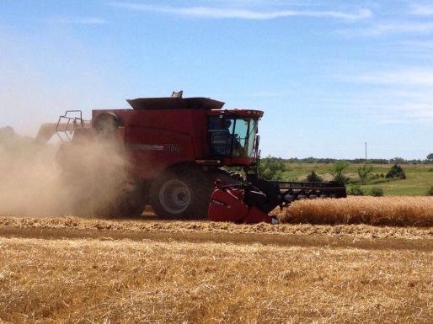
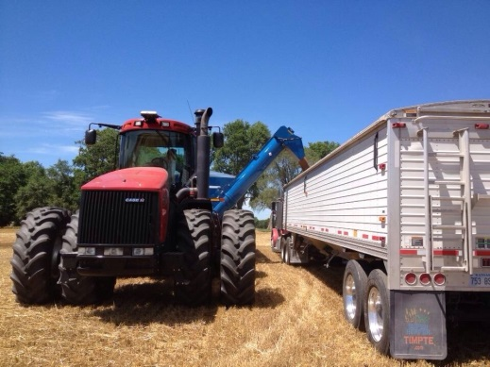
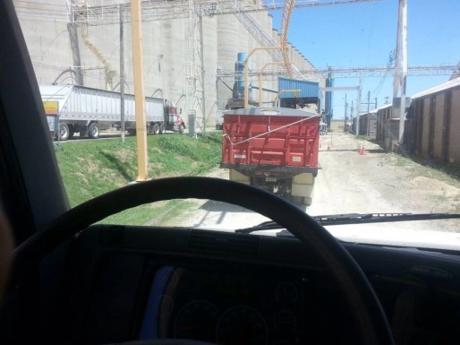
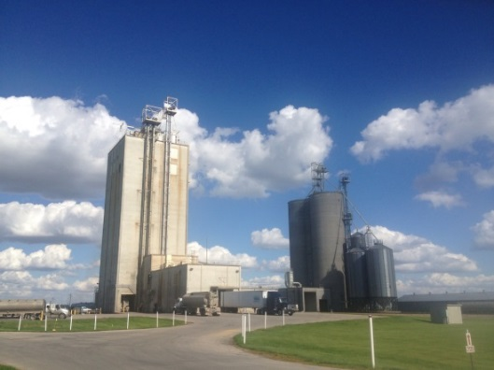
Importance
Loss Characterization
Consumption of product
Costs of sanitation
Repeated treatment costs
Quality loss (product adulteration)
Product rejection by clients/customers
Loss of export markets
Field
Farm
Transportation
Feed Mill
Notes:
Photos of field, farm, transportation, and feed mill: C. Jones

Slide 5
Sanitation Schedule
Depends upon:
  Mill design
  Ingredient type and storage
  Equipment
  Management
  Finished feed storage and transportation
  Pest control
Notes:
There are several species of stored-product insects that are found in raw grains, milled products and in packaged feed. Where and how they infest the product depends on your level of sanitation and pest management practices.

Slide 6
Sanitation Schedule
Week | Monday | Tuesday | Wednesday | Thursday | Friday | Saturday
1 | S, B | S, B | S, B | S, B | S, B | S, B, G, P
2 | S, B | S, B | S, B | S, B | S, B | -
3 | S, B | S, B | S, B | S, B | S, B | S, B, G, E
4 | S, B | S, B | S, B | S, B | S, B | -
Key:
S = sweep all floors
B = remove empty bags from premix area
G = clean grinding room
P = power wash outside of building
E = dry clean equipment

Slide 7
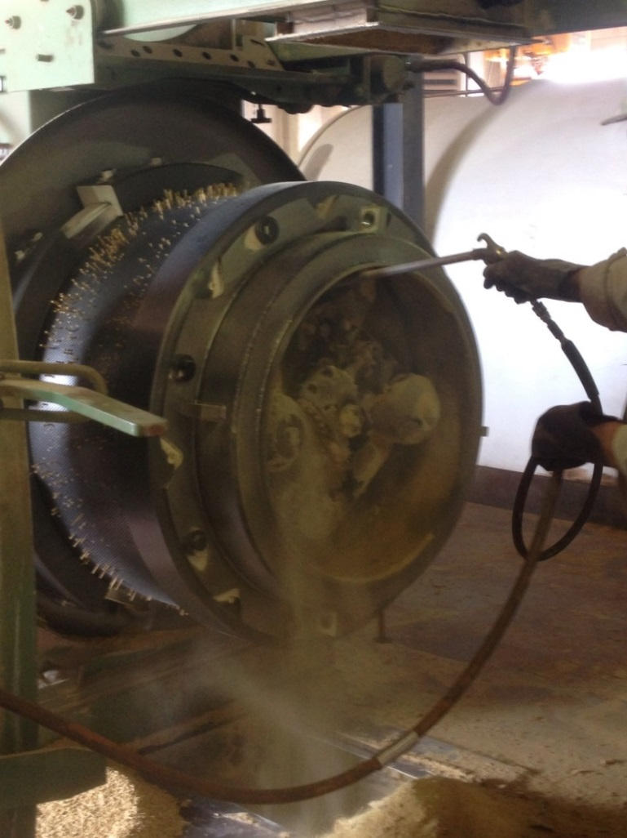
Types of Equipment Sanitation
Easily opened equipment
  Physical
Not easily opened equipment
  Flushing
  Sequencing
Microbial or mold
  Chemical
Notes:
There are several species of stored-product insects that are found in raw grains, milled products and in packaged feed. Where and how they infest the product depends on your level of sanitation and pest management practices.
Photo of dirty equipment: C. Jones

Slide 8
Factors That Influence Pests
Moisture
Food
Shelter
  Suitable Temperature
  Suitable Breeding Environment
  Lack of Pest Suppression
Food
Moisture
Shelter
Notes:
Pests require food, a place to hide, and moisture (especially for rodents and bird and not insects) to survive and reproduce. Pest management involves removing sources of food, eliminating places to hide and breed, and eliminating sources of water. Unknowingly we create conditions that permit these pests to survive and breed.

Slide 9

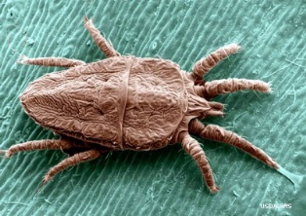
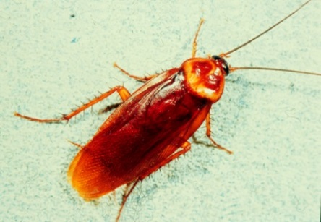
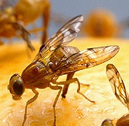

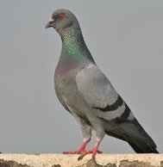
Types of Pests
Invertebrate Pests (no backbone):
Stored-Product
Insects
Mites
Cockroaches
Filth flies
Vertebrate Pests (have a backbone)
Rodents
(rats and mice)
Birds
Notes:
There are several different types of pests that might be present in and around a feed mills. Invertebrate pests do not have a backbone and include insects and mites. Their growth, development, and reproduction varies with temperature as they are cold blooded and do not do well at cooler temperatures. Vertebrate pests, those with backbone, are warm blooded. Their growth and reproduction is temperature independent. Typically stored-product insects and mites cause 5-10% loss of your food products. Pests such as rodents and birds can cause anywhere from 5 to 50% loss depending on the degree of infestation and level of pest management. In addition, insects, rodents, and birds harbor pathogenic organisms; the latter two types of pests have been implicated in many public health diseases.
Photo of insects, rat and bird: USDA
Photo of cockroach: Virginia Tech

Slide 10
Stored-Product Insects
Feed and reproduce on:
  Stored raw grain (farms, elevators, feed mills)
  Milled products
  Finished feed
Controlled with fumigation
  Saturate area with pesticide in vapor form to suffocate stored-insect pests
  Fumigant must be controlled
    Sealed environment, fumigant release, holding period, ventilation
    Methyl bromide use now restricted; phosphine,
    1,3-dichloropropene, chloropicrin, formaldehyde most common

Slide 11
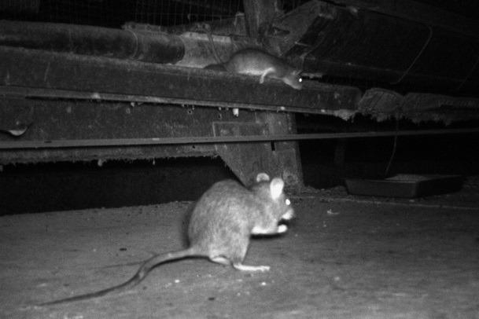
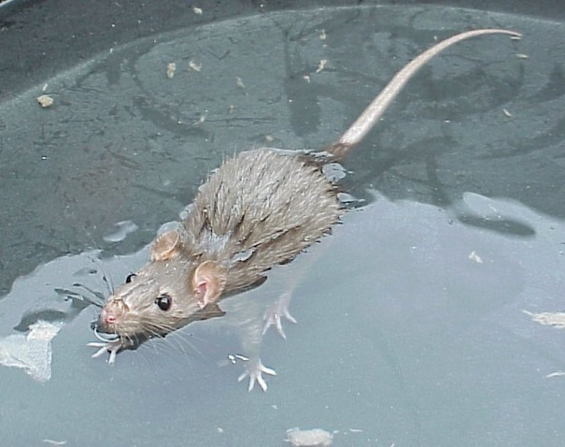
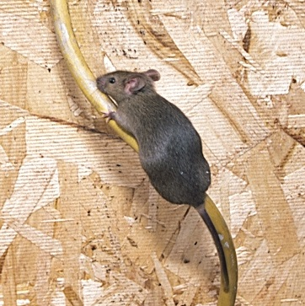
Rodents
Nocturnal in habit
Excellent swimmers
Good climbers
Good sense of smell and hearing
Can gnaw through wide variety of materials
Can enter through very small openings
  ¼” (diameter of a pencil)
Tail
  Variable length, furry, scaly, or bare
  Cools the animal
  Prehensile
  Provides balance
Notes:
Rodents are active at night, therefore nighttime inspections are best to find the source of rodents. They are excellent swimmers and climbers, and have a good sense of smell and hearing. They have strong teeth than can chew through lead sheathing, aluminum, and wood.
Mice require a hole size of quarter inch to enter a building, rats requires a hole that is half an inch.
The tail of rodents is hairy and used for balance and for hanging on to structures. It also cools the animal.
Photo of rat eating, swimming and climbing: T. Bruesch

Slide 12
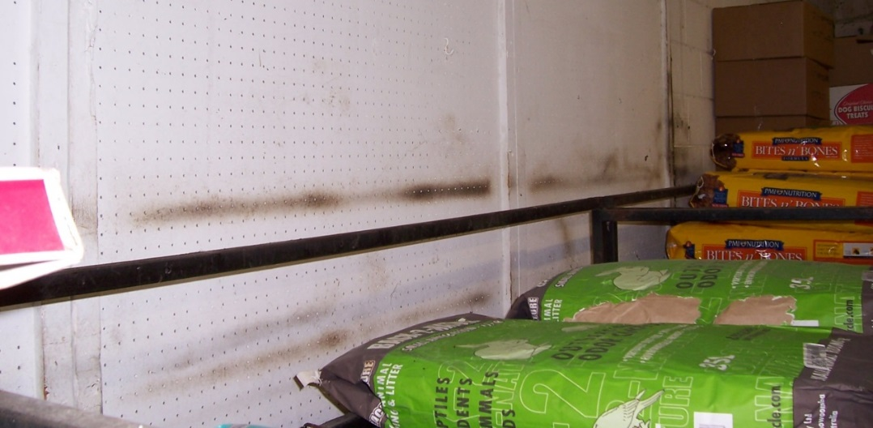
Rodents
Problem:
  Typically 1/5 of our food supply is consumed by rodents
  Burrowing damage
  Growth of teeth: 0.4 mm per day; 6 bites per second
    Risk: Cross-contaminate ingredients, finished feeds
    Risk: disease transmission
Notes:
The actual number of rodents in a given area is difficult to estimate. There could be several colonies of rodents that are spatially separated in an area. Since rodent activity is cryptic (hidden) it is difficult to know how many other individuals are present when you notice one. Rodents consume one-fifth of our food supply. Prevention of rodent damage to crops in the field can help in feeding 34% of the world’s population (278 million people) that is currently malnourished. Rodents make burrows and damage electrical wiring through their chewing habits. Rodents possess strong teeth which grow at a rate of 0.4 mm per day. Therefore, rodents need to gnaw or file their teeth to stop the growth. They can bite 6 times per second. Mice are smaller and consume 10 times less than rates. Rodents are incontinent and urinate as they are foraging for food. They also drop 20 to 100 fecal pellets per day. Looking for rodent fecal pellets along rodents runways, typically floor-wall junctions, is a sign of their presence and activity. Rodents are vectors of several pathogens and to date more than 10 million people have died due to rodent-brone diseases.
Photo of rat grease: T. Bruesch

Slide 13
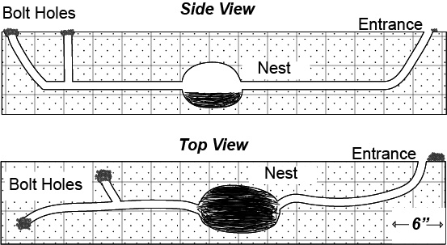
Signs of Rodent Infestation
Rodent droppings and urine stains
Rodent tracks
Gnawing damage
Burrows
Runways
Grease marks
Rodent sounds
and odors
Image: KSU
Notes:
Signs of rodent infestation includes presence of fecal pellets (droppings) and urine stains. Rodent urine and hair fluoresce under UV light. The fluorescence may look bluish-white to yellowish-white when viewed under a black light (350-450 nm). Understand that some compounds are UV reactive and fluoresce as well such as bleaches and packaging glues. Rodent hair fluorescence will be bluish-white. In dusty environments such as in feed mills rodent tracks can indicate their presence. The size of tracks can be used to separate whether the rodent is a Norway rat, roof rat, or a house mouse. The shape and size of fecal pellets also is a diagnostic character to separate the three species. Other signs of rodent damage include gnawing marks, burrows in the ground, runways made by rodents because of constant use, greasy marks on runways used by rodents, and rodent sounds and odor. Rodent leave grease marks because of oily secretions from hairs.
Rodent burrows have multiple entrances and exits. Careful inspection of grounds outside the feed mill will show where the burrows are! Roof rats are found in areas above the ground.
Graphic of rodent hole: Kansas State University

Slide 14
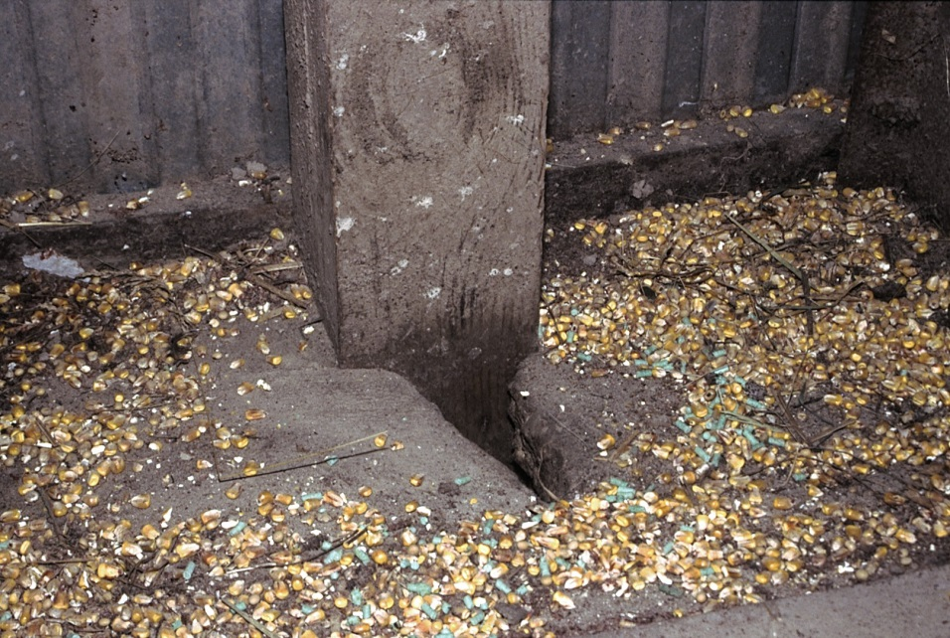
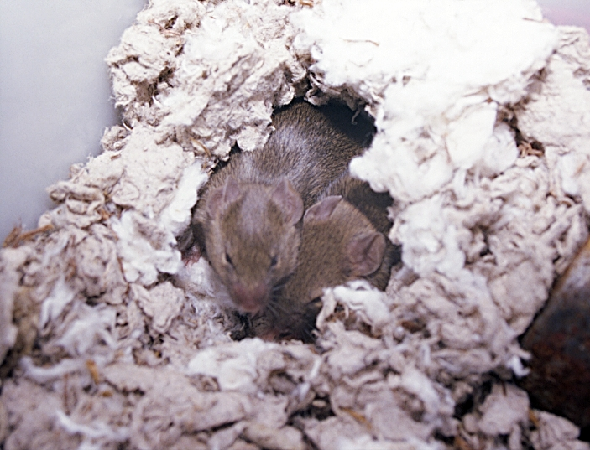
Nesting Material and Rodent Damage
Notes:
Another sign of rodent infestation is the presence of chewed up material, which is used as nesting material for pups. The use of nests appears to be an acquired rather than a genetic behavior.
Photo of rat and mouse nests: T. Bruesch

Slide 15
Birds
Subjective and based on perception, sensitive issue
Some birds are protected by federal, state, and local laws
Birds become pests when they enter feed mills, roost near loading docks, build nests in drains/down spouts, defecate on doors/windows, loaf around air intake ducts
Notes:
Not all birds are pests. It is difficult for some people to comprehend that pigeons are pests, especially when they are present in parts or in places of interest. There are several species of birds that are federally protected and should not be killed; some birds are on the endangered species list. However, in grain storage and processing facilities birds are commonly found and these birds feed on spilled materials and enter facilities when doors are opened. Birds in and around feed mills create an unhygienic environment by defecating in areas where they feed or roost. Some pest birs include sparrows, crows, European starlings, and pigeons.

Slide 16
Other Pests
Cats and dogs?
  Both pests and pest control methods
  Discretion of mill management
Notes:
Photo: Clip Art

Slide 17
Why Are Pests Present?
Food
Moisture
Shelter
Notes:
As stated before, pests are present because of food, shelter, and moisture. Removal of the three things that support life will eliminate or minimize pest problems in and around your feed mill.

Slide 18
Pest Management Tactics
Inspection
Sanitation
Exclusion
Landscape design
Building design
Develop scope of pest management services
Notes:
Inspection is the first step of proper pest management. Inspections, primarily visual, help in determining the presence and magnitude of a pest problem. Additionally, careful inspections help in identifying the source of pests.
Sanitation involves various aspects a feed mill does daily, including maintaining clean grounds to clean equipment, and multifaceted programs to produce a clean product.
Exclusion involves all tactics one uses to prevent things from ending up in the food product, and these things can range from keeping doors and windows closed to sealing cracks and crevices at floor-wall junctions, and ensuring the package with finished feed product has tightly sealed seems to prevent insect entry.
As stated before, pests from the outside, if given an opportunity can gain access into a feed mills. Having vegetation outside a feed mill creates an ideal environment for pests to hide and breed. For example, trees allow birds space to build nests.
Building should be designed to conduct proper pest management, such as having a two feet vegetative barrier zone on the outside perimeter of the building, grading of grounds to prevent accumulation of water, and construction such that pests cannot land on window ledges.
Typically, pest management is not done internally and is usually outsourced to a pest management service provider. The service provider and the feed mill management should sit and discuss the scope of services, which can range from monthly inspections, monitoring of pests, to documenting that the service is having an impact of pest populations and resulting in less use of chemicals over time. The service provider should understand the mill sanitation issues and their impact on effectiveness of pest management. Periodic review and revision of the scope of services may be necessary to fine tune it.
Hire competent pest management service provider and have a list of things they can and cannot do on premises that would compromise your product safety.

Slide 19
Integrated Pest Management
Concepts:
  Manage pests so activity does not reach unacceptable levels
  Use multiple tactics
  Use pesticides only as a last resort
  Prevent access to food, shelter, and moisture
Notes:
Integrated Pest Management or IPM is not a new concept. It has evolved over time since the 40s and has taken a strong foothold in the 70s, primarily for management of forest and field crop pests. The basic concepts of IPM are very simple. It deviates from the past thinking of going for total elimination of pests. IPM involves the use of multiple tactics that are compatible to reduce populations below a level considered acceptable. What this level is varies from pest to pest, facility to facility and location to location. IPM is an ecological approach with positive environmental and social consequences. IPM does not profess using less chemicals, but it encourages using several non-chemical tactics so there is an overall reduction of chemical use. It forces facility managers and service providers to think of ways to remove access to food, shelter, and moisture, and understand the response of pests to sanitation and pest management tactics.

Slide 20
IPM:
Inspect, Monitor, Assess, Evaluate
Inspection
  Visually inspect inbound and outbound material, mill interior and exterior
  Identify source of pests, sanitation issues
  Correct obvious issues
Monitoring
  Traps and mechanical devices
Assessing
  Pest density and distribution
Evaluation
  Implement tactics, evaluate impacts/benefits
Notes:
The key to successful IPM starts with inspection and prevents mill managers or service providers from blindly following a calendar-based application of pest intervention methods. Every feed mill should have an inspection check list that is customized to detect and correct issues as they emerge. It is important to start inspecting the mill exterior starting from the property line and moving towards the mill. Look for signs of infestation such as rodent burrows to conditions that could comprise your sanitation such as bird fecal material, water accumulation, and branches touching the mill windows. Inspection also pertains to materials that you plan to bring into your mill or materials that you plan to ship to your customers. The whole idea of inspections is to take corrective action in real time and determine what can be done to make the issue found a part of the mill’s preventive program.
Monitoring for pests is nothing but sampling pests over time. Monitoring can be visual or with the use of various devices that work 24 hours a day, 7 days a week. Monitoring will let the mill managers know whether a pest has exceed a level for intervention. It also helps understand pest dynamics over time and determine the correct time for intervention. Monitoring also helps understand the degree and duration of pest suppression attained due to sanitation and pest intervention.
Pest infestation generally start in one location and then spread to other locations from a focal point. Inspections and monitoring help in defining the presence, numbers, and spread of infestations. They can also show the impact of sanitation and pest management on the presence, numbers, and control of the infestations.
Periodic examination of monitoring data will indicate the benefits of IPM and such an evaluation is necessary to revise it as needed.

Slide 21
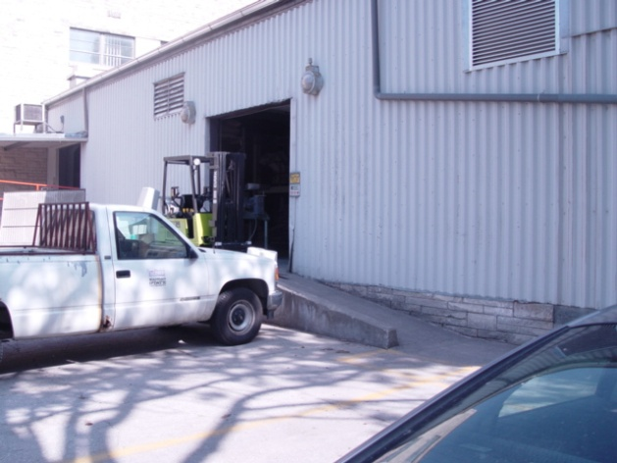
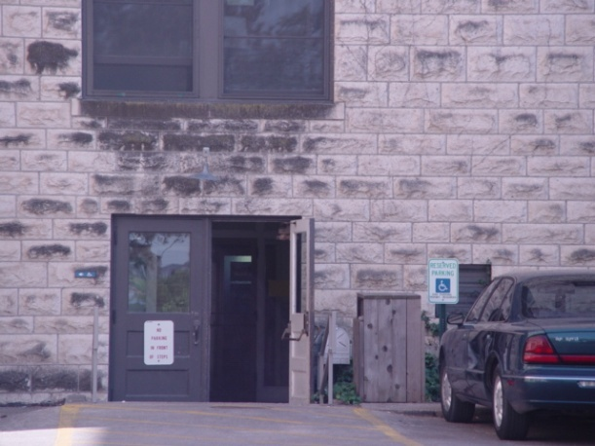
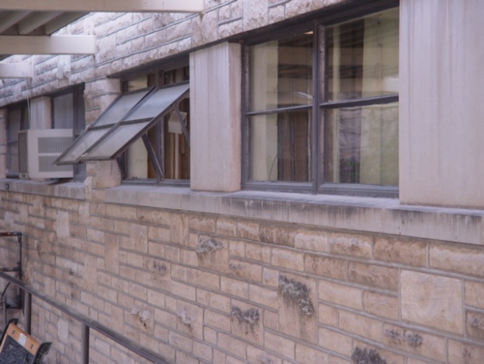
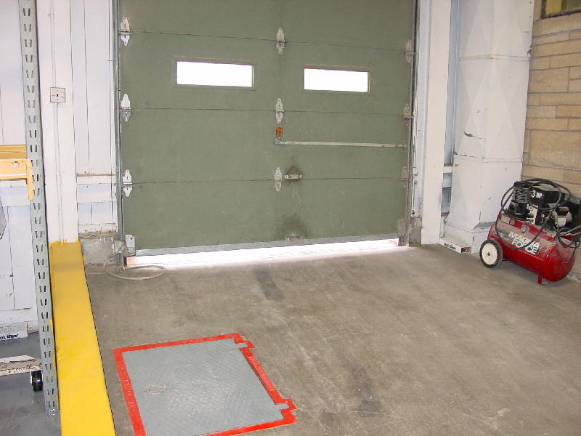
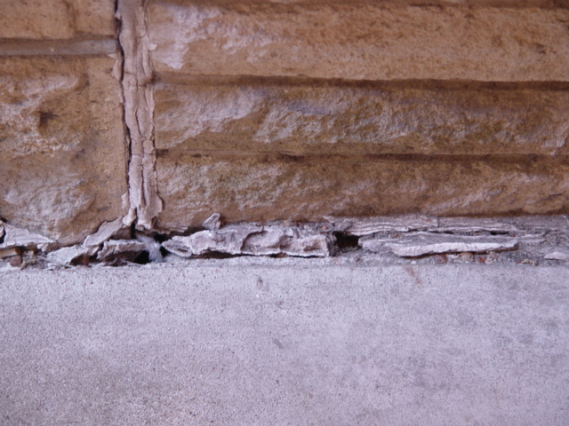
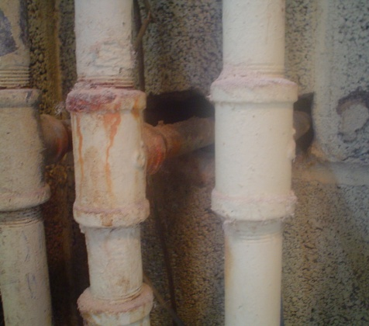
Inspection: Deny Pest Entry
Notes:
During inspections identify places where pest can gain entry into the mill. Here are examples that show areas from which pests can enter the mill. Close doors, windows, and shutters. Windows should have screens to prevent pest entry; the mesh size should be 150 to 180 microns. Look at floor-wall junction on the building exterior and seal such gaps. Look for pipes going between walls from the outside to the inside or between mil interior walls. If not sealed with steel wool or concrete these openings serve as pest highways. Develop and enforce policies to make sure that exclusion practices are strictly followed.
Photos of entrances: Kansas State University

Slide 22
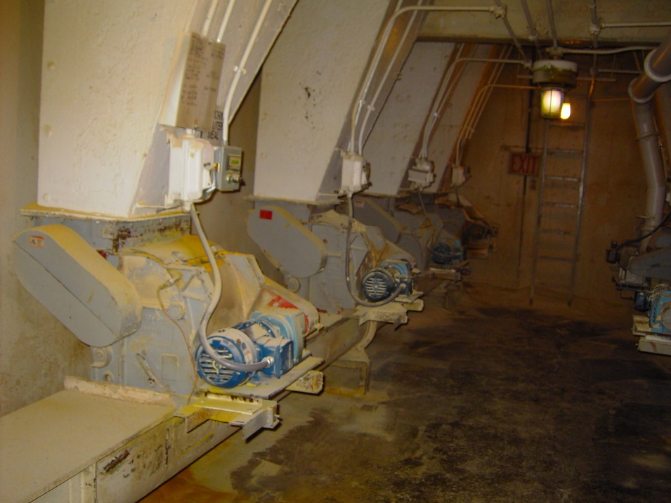
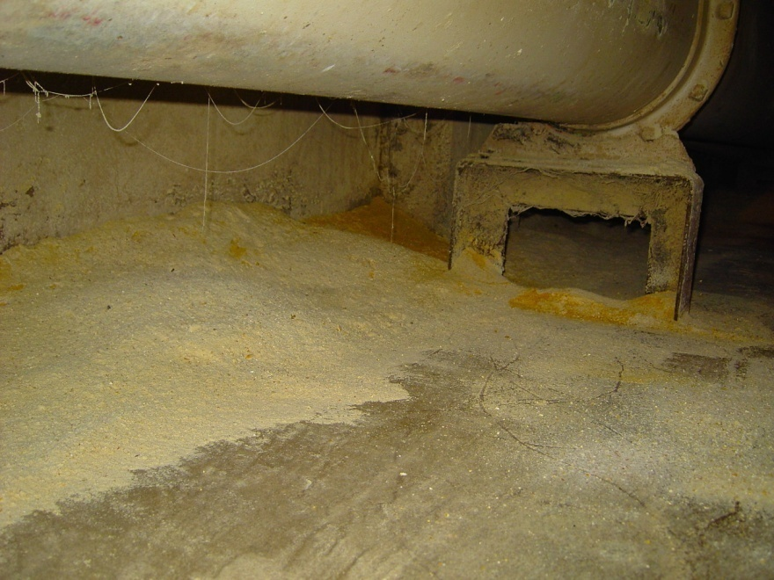
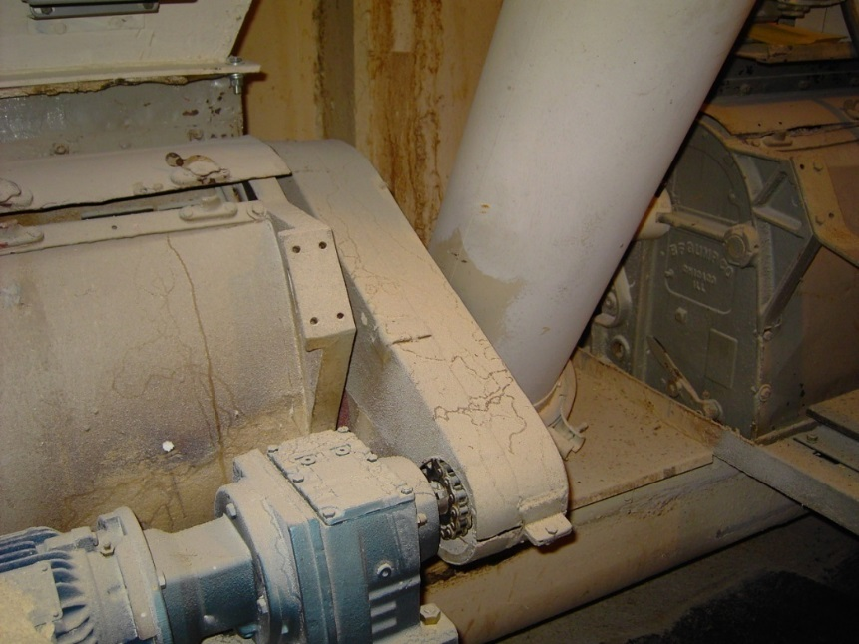
Inspection:
Prevent Access to Food
Notes:
Here are some bad examples from a feed mill. A place with such product accumulations underneath and on equipment will lead to continuous pest infestations. If the accumulations are a result of poor equipment design or damage, these aspects should be examined and corrected to prevent a future problem.
Photos of access to food: Kansas State Univeristy

Slide 23
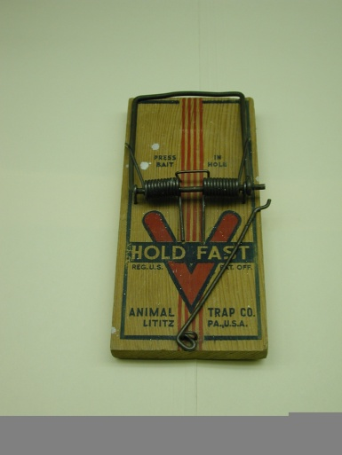
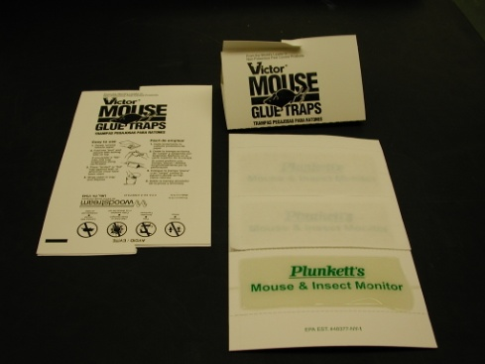
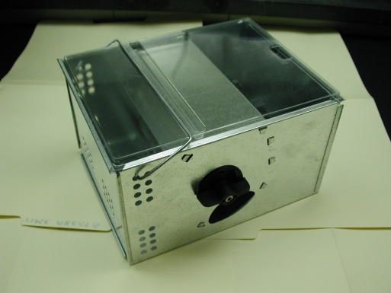
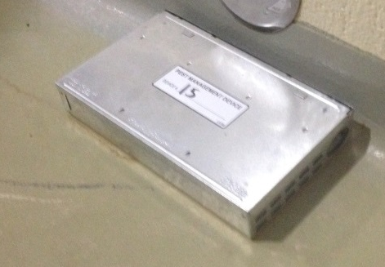
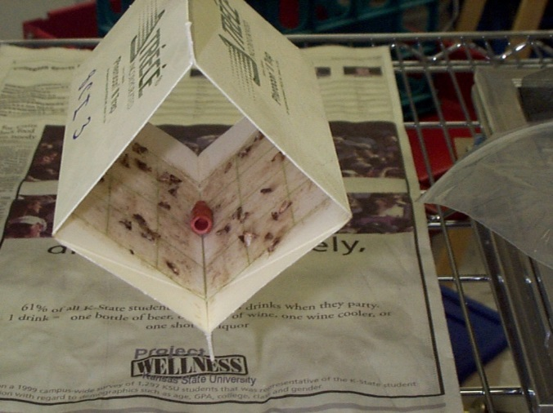
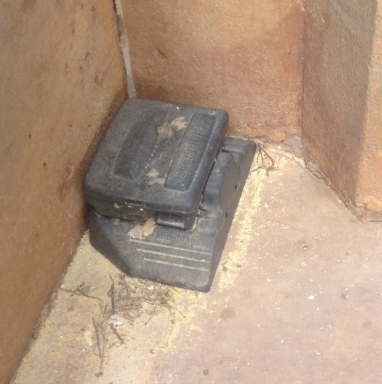
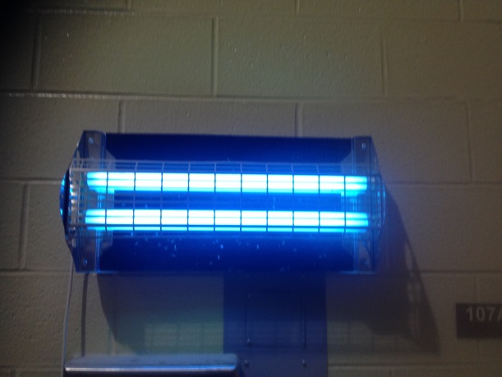
Monitoring:
Traps/Mechanical Devises
Notes:
There are several commercial devices for stored-product insects, cockroaches, flies, and rats and mice. The ones for rodents and flies could also serve as management devices, but insects and mites they are generally used for monitoring purposes. Insect monitoring devices such as pheromone traps shown at the left bottom has been used for disruption mating and mass trapping, two methods designed for managing pests inside mills. Using the right device for the right pest is essential.
Photo of light trap, outside rodent trap, inside rodent trap: C. Jones
Photo of wooden mouse trap, rat glue, insect pheromone trap: C. Jones

Slide 24
Assess:
Identify Pest Type, Density or Level
Once new entry is minimized and pests are trapped:
  Identify type of pest to determine appropriate tactic
  Identify density and distribution of pests throughout mill to determine ideal placement of mitigation
Notes:
Identifying whether one has an accidental invader versus a pest that can contribute to economic loss is important. Proper pest identification will allow one to use the right tactics to manage it. A wealth of popular and scientific information is available from various institutions and pest management professionals regarding effective tools ot manage specific pests.
The mere presence of pest does not deserve an intervention. Remember, as mentioned below, one needs to determine if a pest has reached a level that is unacceptable. This level is determined by historical issues, product returns, customer complaints, or just the risk-averse nature of the feed mill manager to infestations. These levels are generally called action thresholds and thresholds can be as simple as stating that a pest management intervention will be instituted if 20% of the monitoring devices has one or more insects inside the mill. The intervention can be as simple as sanitation or use of an aerosol, use of a residual product, fumigation, or heat treatment. Sometime one can make a decision stating that if the average density of insects in the 30 traps placed in the mill exceeds on average exceeds 10 insects/trap/week an intervention will be employed. Again, one has to balance intervention decisions with cost and effectiveness.

Slide 25
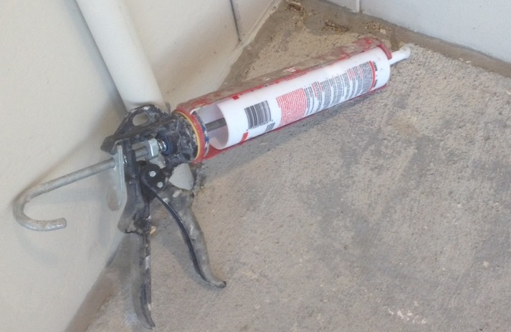
Evaluation: Implement Tactics
Crack/crevice treatments for insects
Fogging for insects
Heat treatment for insects
Use of fumigants for insects
Use of baits (chemical and nonchemical)-insects, rodents, birds
Notes:
Any implemented tactic should be evaluated either through visual sampling or by monitoring devices. An evaluation could be as simple as asking what the pest numbers were before and immediately after the intervention. Typically pest interventions that reduce numbers by 90% or more are considered effective. Another question to ask is how long it took for the suppressed pest populations to reach the established action thresholds after an intervention. This would tell you if a single or multiple sanitations or a single fumigation or a single heat treatment was effective for a week, two weeks, four weeks, one month or two months.
Photo of caulking: C. Jones

Slide 26
Potential Feed Safety Hazards
Physical: pest bodies, plastic traps
Chemical: cleaners, pesticides and fumigants
Biological: pathogens passed by pests, molds if wet chemical treatment and not dried properly

Slide 27
Lesson Summary
1. The feed mill manager is usually charged with the responsibility of carrying out the sanitation and pest management program, but sometimes uses an external pest management company instead of a trained employee for pest mitigation practices.
2. Common pests in the feed mill include stored product insects, mites, cockroaches, flies, rodents, and birds.
3. A pest control program includes sanitation, inspection, storage of equipment, ingredients and feed, physical and mechanical controls, and either a pesticide/poison baiting program or external pest control program.
4. Traps, exclusion, and landscape and building design are pivotal to prevent and reduce pests, but records should be maintained to track this over time.

Slide 28


This course was made possible by:
*Funding for this Grain and Feed Mill Operations course was made possible, in part, by the Food and Drug Administration through grant (1U54FD004333-01), views expressed in written materials or publications and by speakers and moderators do not necessarily reflect the official policies of the Department of Health and Human Services; nor does any mention of trade names, commercial practices, or organization imply endorsement by the United States Government.*

