Slide 1
WELCOME!
VM 101 | Wheat Processing
Dr. Cassie Jones
Assistant Professor of Feed Technology
Kansas State University
Manhattan, KS
jonesc@ksu.edu

Slide 2
Lesson Objectives
By the end of the lesson, participants will be able to:
Recognize components of wheat processing prior to receipt at feed mill
Identify classes of wheat and wheat by-products commonly used as animal feed ingredients
List food safety hazards associated with wheat and wheat by-products
Identify specialized equipment used to process wheat and wheat by-products
Slide # 2

Slide 3
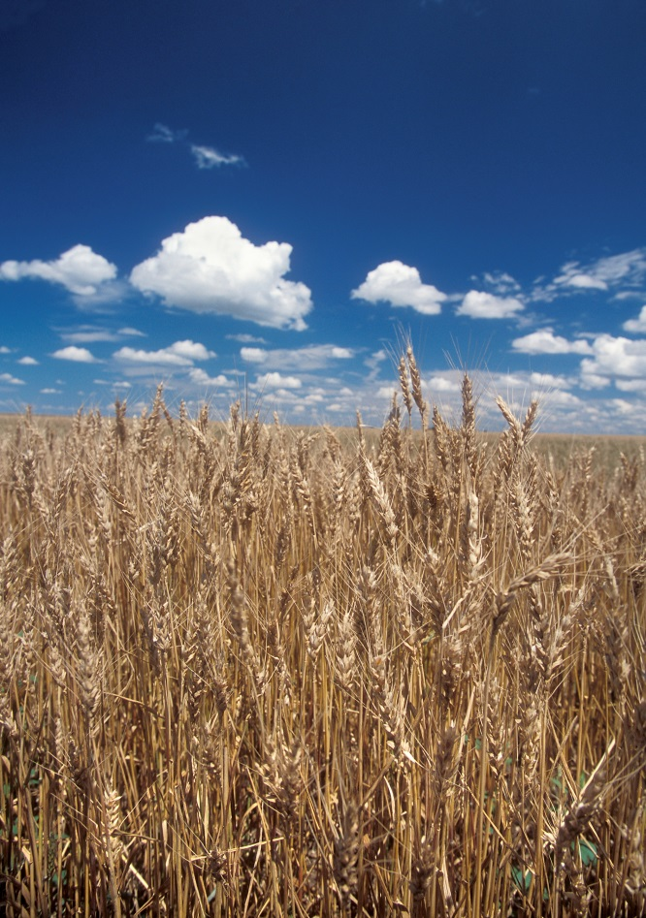
Importance & Relevance
Wheat is #3 field crop in U.S.
Total acres have dropped 1/3 since 1981
Whole wheat (ground or steam-flaked)
75% flour
25% wheat by-products (midds, screenings)
Slide # 3
Notes:
Photo: USDA

Slide 4
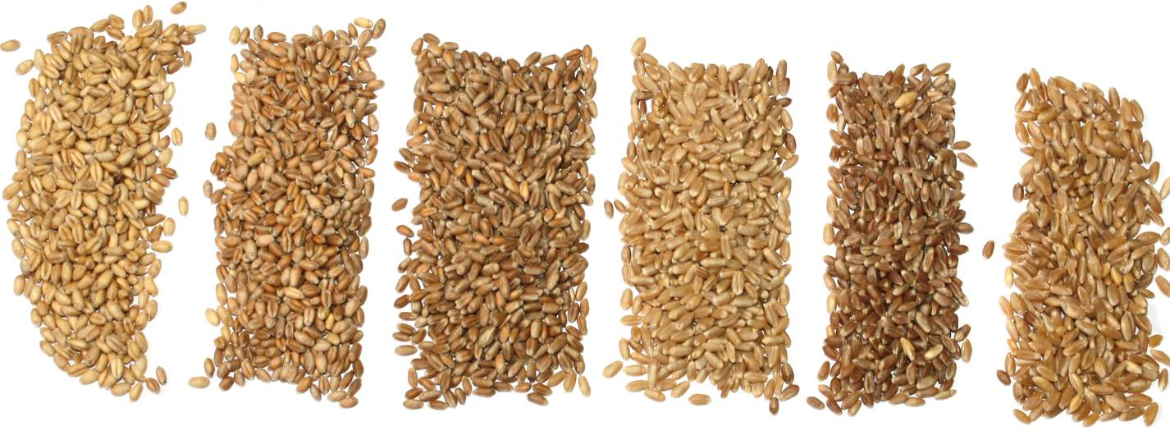
Six Wheat Classes
Soft White
Soft Red Winter
Hard Red Winter
Hard White
Hard Red Spring
Durum
Slide # 4
Notes:
Photo: Chris Miller

Slide 5
Six Wheat Classes cont.
Slide # 5
Notes:
Graphic: U.S. Wheat Associates

Slide 6
Process Flow
Wheat from Field
Cleaning
Screenings
Tempering
Grinding
Middlings
Sifting
Germ
Flour
Purification
Red Dog
Slide # 6

Slide 7
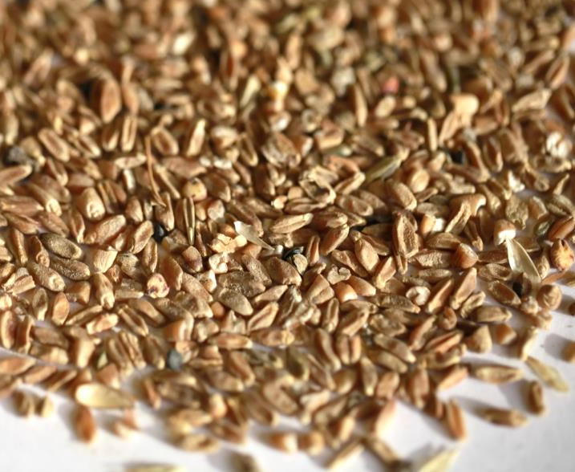
Wheat Cleaning
Wheat cleaned to remove:
Non-Wheat Material
Sticks, straw, stones, insects
Wheat Not Fit for Milling
Broken, damaged, small kernels
Slide # 7
Notes:
Photo: Chris Miller

Slide 8
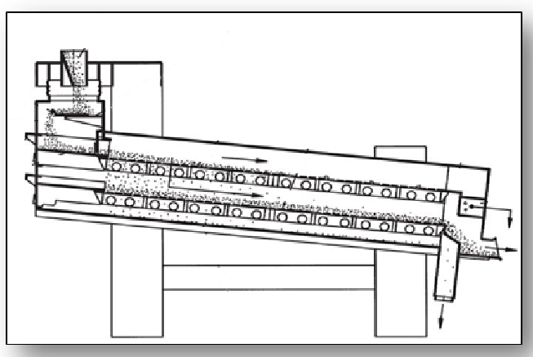
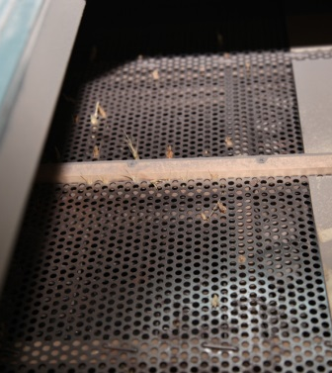
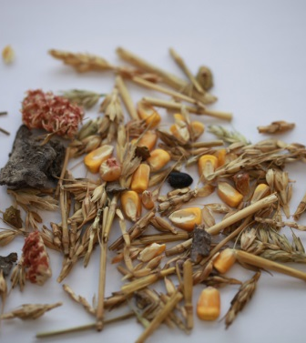
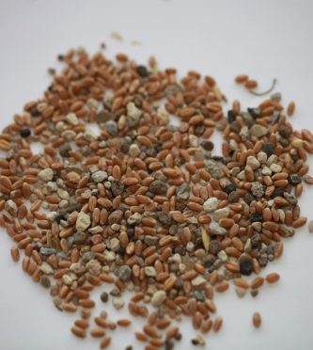
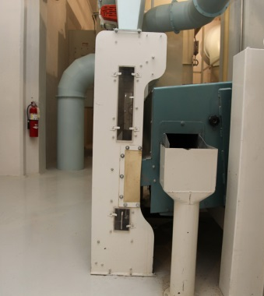
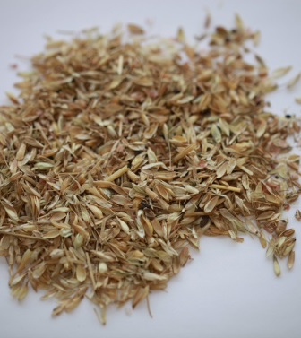
Wheat Cleaning, cont.
Receiving Separator cleaning non-wheat material
Slide # 8
Notes:
Photo of Separator Machine: Chris Miller
Photo of Screen: Chris Miller
Photo of non-wheat: Chris Miller
Photo of small stones and non-wheat: Chris Miller
Photo of separator machine side view: Chris Miller
Photo of chaff: Chris Miller
Line drawing of separator machine:

Slide 9
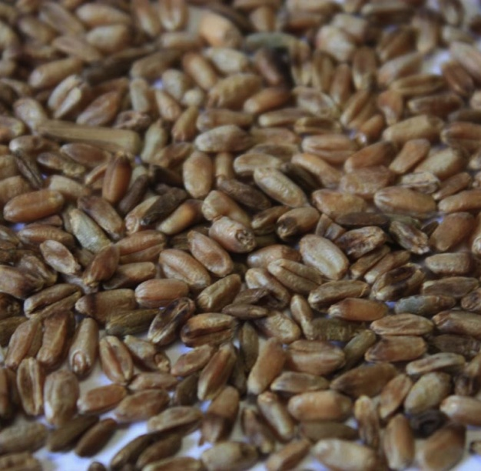
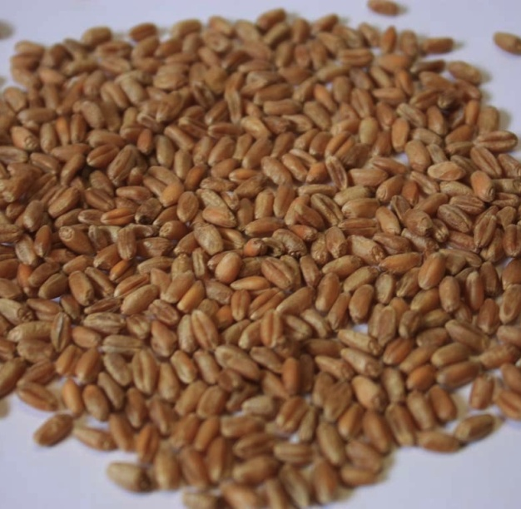
Wheat Cleaning, cont.
Digital Optical Color Sorter
cleaning wheat not fit for milling
Slide # 9
Notes:
Photo of sorter machine: Chris Miller
Photo of dark wheat: Chris Miller
Photo of red wheat: Chris Miller

Slide 10
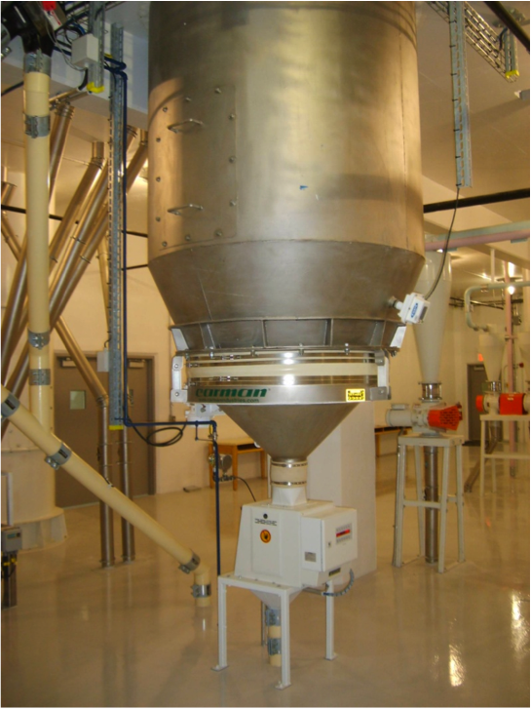
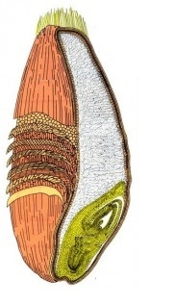
Wheat Tempering
Water/heat/steam applied to wheat and rested
Soften endosperm
“Toughen” bran
Bran
Endosperm
Germ
Tempering System
Wheat Foods Council
Slide # 10
Notes:
Photo of tempering machine: Chris Miller
Graphic of wheat kernel: Wheat Foods Council

Slide 11
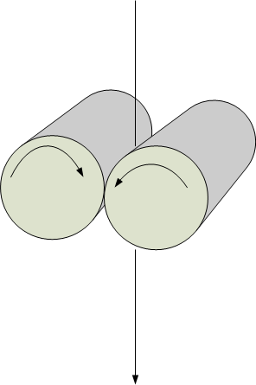
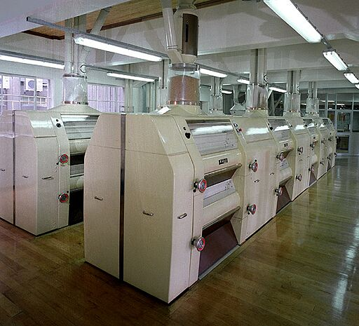
Wheat Grinding
Grinding actions
Corrugations
Pitch
Spiral
Rolls and Corrugations
Slide # 11
Notes:
Photo of roller mills: Chris Miller
Graphic of rolls: Chris Miller
Graphic of corrugations: Chris Miller

Slide 12
Wheat Sifting
Slide # 12
Notes:
Photo of sifter machine: Chris Miller
Graphic of particle separation: KSU

Slide 13
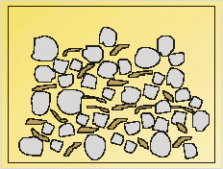
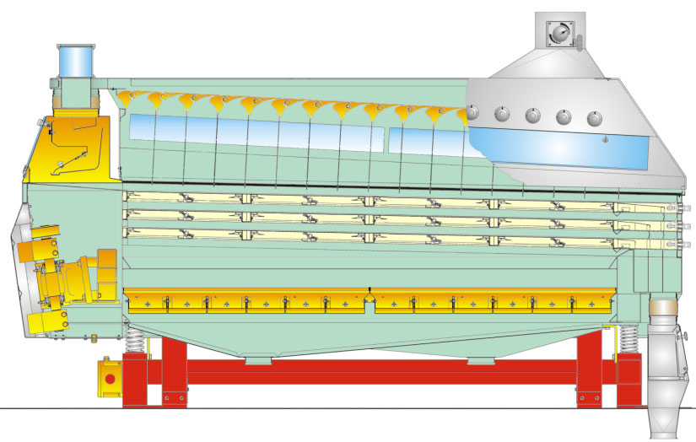
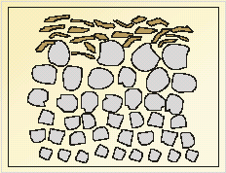
Wheat Purification
Product Inlet
Air flow Out
Before
Air flow IN
After
Particle Separation:
Mark Fowler, October 2012
Slide # 13
Notes:
Line drawing of purifier machine:
Line drawings of particle separation:

Slide 14
Processing Prior to Feed Mill
Wheat from Field
Cleaning
Screenings
Tempering
Grinding
Middlings
Sifting
Germ
Flour
Purification
Red Dog
Slide # 14

Slide 15
Wheat By-Products
Cleaning
Screenings
Tempering
Grinding
Middlings
Sifting
Germ
Purification
Red Dog
Slide # 15
Notes:
Photos of wheat by-products: KSU

Slide 16
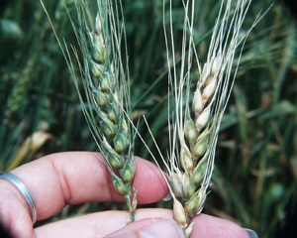
Potential Feed Safety Hazards
Physical Hazards
Non-grain material in screenings not caught by magnets
Chemical Hazards
Chlorine used in tempering
Pesticides/agrochemicals
Microbial Hazards
Mold (Vomitoxin)
Wheat Contaminated by Vomitoxin
Slide # 16
Notes:
Photo of wheat contaminated by Vomitoxin: USDA

Slide 17
Lesson Summary
Prior to reaching the feed mill, wheat is processed by cleaning, tempering, grinding, sifting, and purification
The six classes of wheat are soft white, soft red winter, hard red winter, hard white, hard red spring, and durum
The most common wheat by-products are wheat screenings and wheat middlings
Potential feed safety hazards associated with wheat or wheat by-products include non-grain material, chlorine, pesticides or vomitoxin
Receiving separators, roller mills, sifters, and purifiers are important equipment
Slide # 17

Slide 18
This course was made possible by:
*Funding for this Grain and Feed Mill Operations course was made possible, in part, by the Food and Drug Administration through grant (1U54FD004333-01), views expressed in written materials or publications and by speakers and moderators do not necessarily reflect the official policies of the Department of Health and Human Services; nor does any mention of trade names, commercial practices, or organization imply endorsement by the United States Government.*

