Slide 1
Fall 2021 Registration Q &A Session March 24, 2021

Slide 2
Fall 2021 Registration
Check for March 9 email from Lydia outlining the Process and Procedures
Plan ahead: Put together a schedule of classes for F21 plus the next 3 semesters (or until your planned graduation date - whichever comes first).
Specific procedures and preferences VARY by adviser e.g. Dr. Luvaga's Freshman Students: There will be group advising sessions by Learning Team. Watch for an e-mail from her.
Do not wait until last minute to schedule an appointment or meet with your advisor

Slide 3
Advisor Appointments and Scheduling
BOESSEN: There will be group advising appointments. Watch for an email with specifics
BRANDAU: Watch for an email with info about an overview session
DEITER: Watch for an email with specific instructions on making an appointment.
ELOBEID: Email her directly to schedule an appointment.
LUVAGA: There will be group advising sessions by Learning Team or e-mail her
WOHLGEMUTH: There will be group advising. Watch out for an email from Dr. Wohlgemuth.

Slide 4
Where to Find Your Registration Start Date and Time

Slide 5
Log into AccessPlus

Slide 6
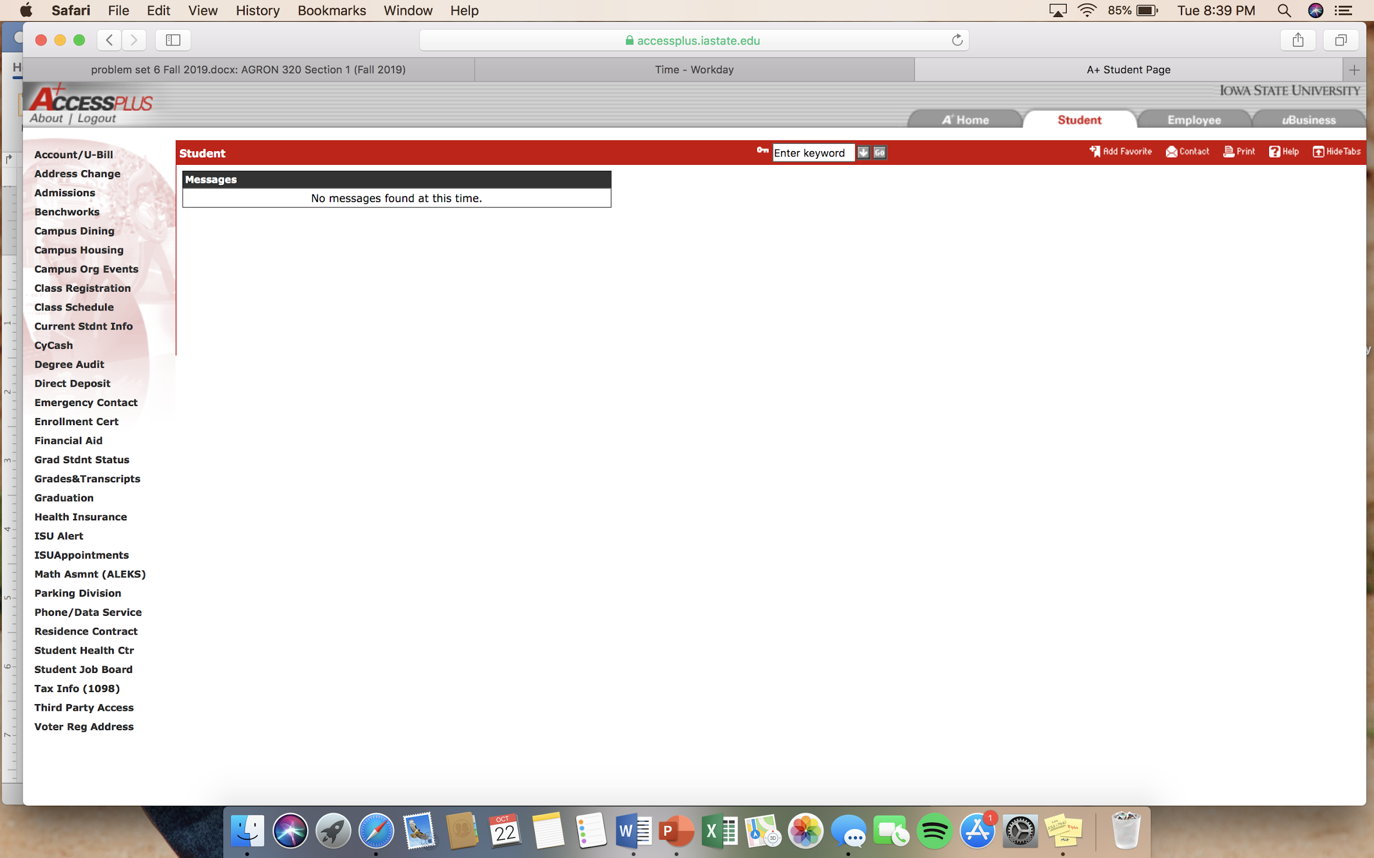
Click on the student tab

Slide 7
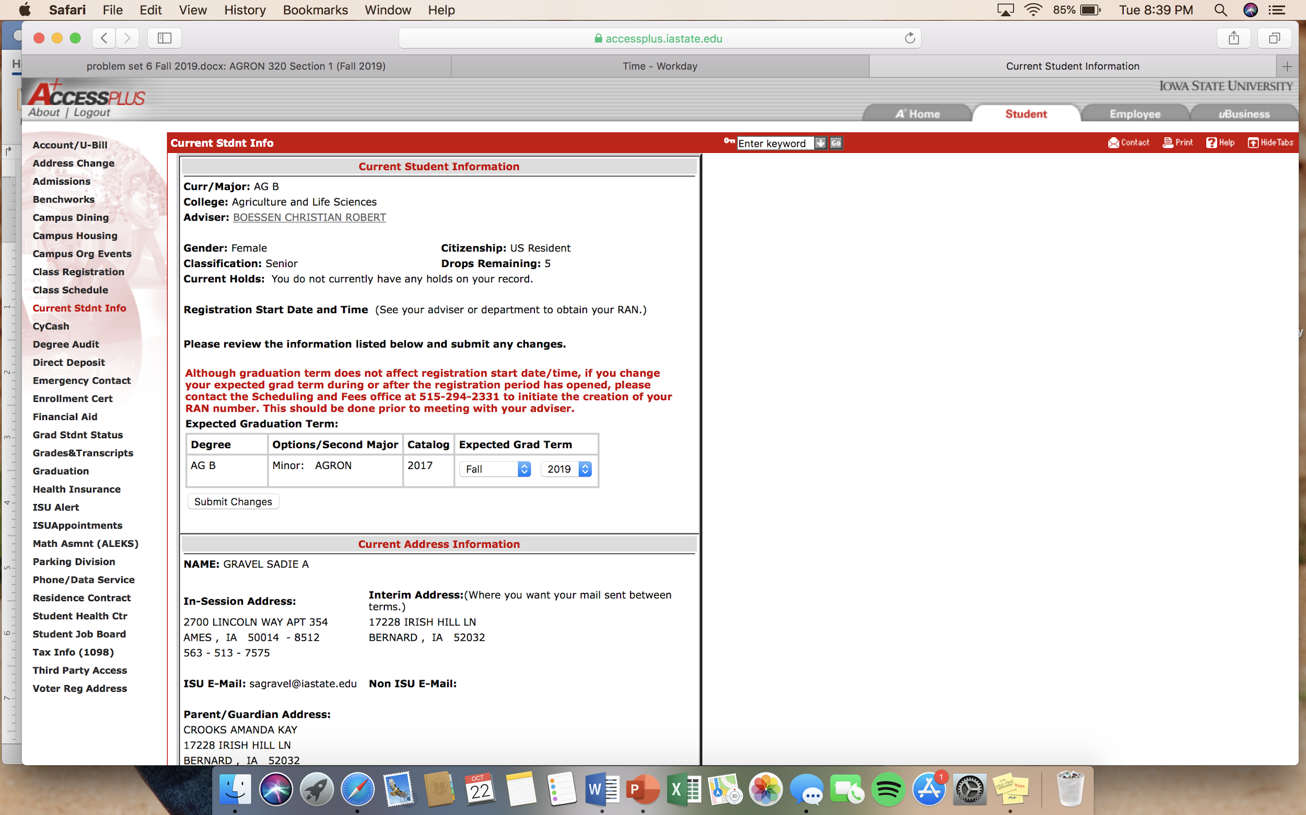
Find date here!

Slide 8
Fall 2021 Registration
You will register through AccessPlus on the web.
Hours: 7:00a.m. -11:00 p.m., Mon.-Sat., and most Sundays
Your advisor will give you your Registration Access Number (RAN)
To register for more than 18 credits, let your advisor know
To change the catalog from your current one, talk to your advisor
To change your graduation date, do so yourself in AccessPlus

Slide 9
Holds
Any hold will stop you from registering for classes, and therefore delay your registration
Clear all holds before your start date
Examples of holds: Academic, Financial, other?
How do I know if I have a hold?

Slide 10
How to Register For Classes

Slide 11
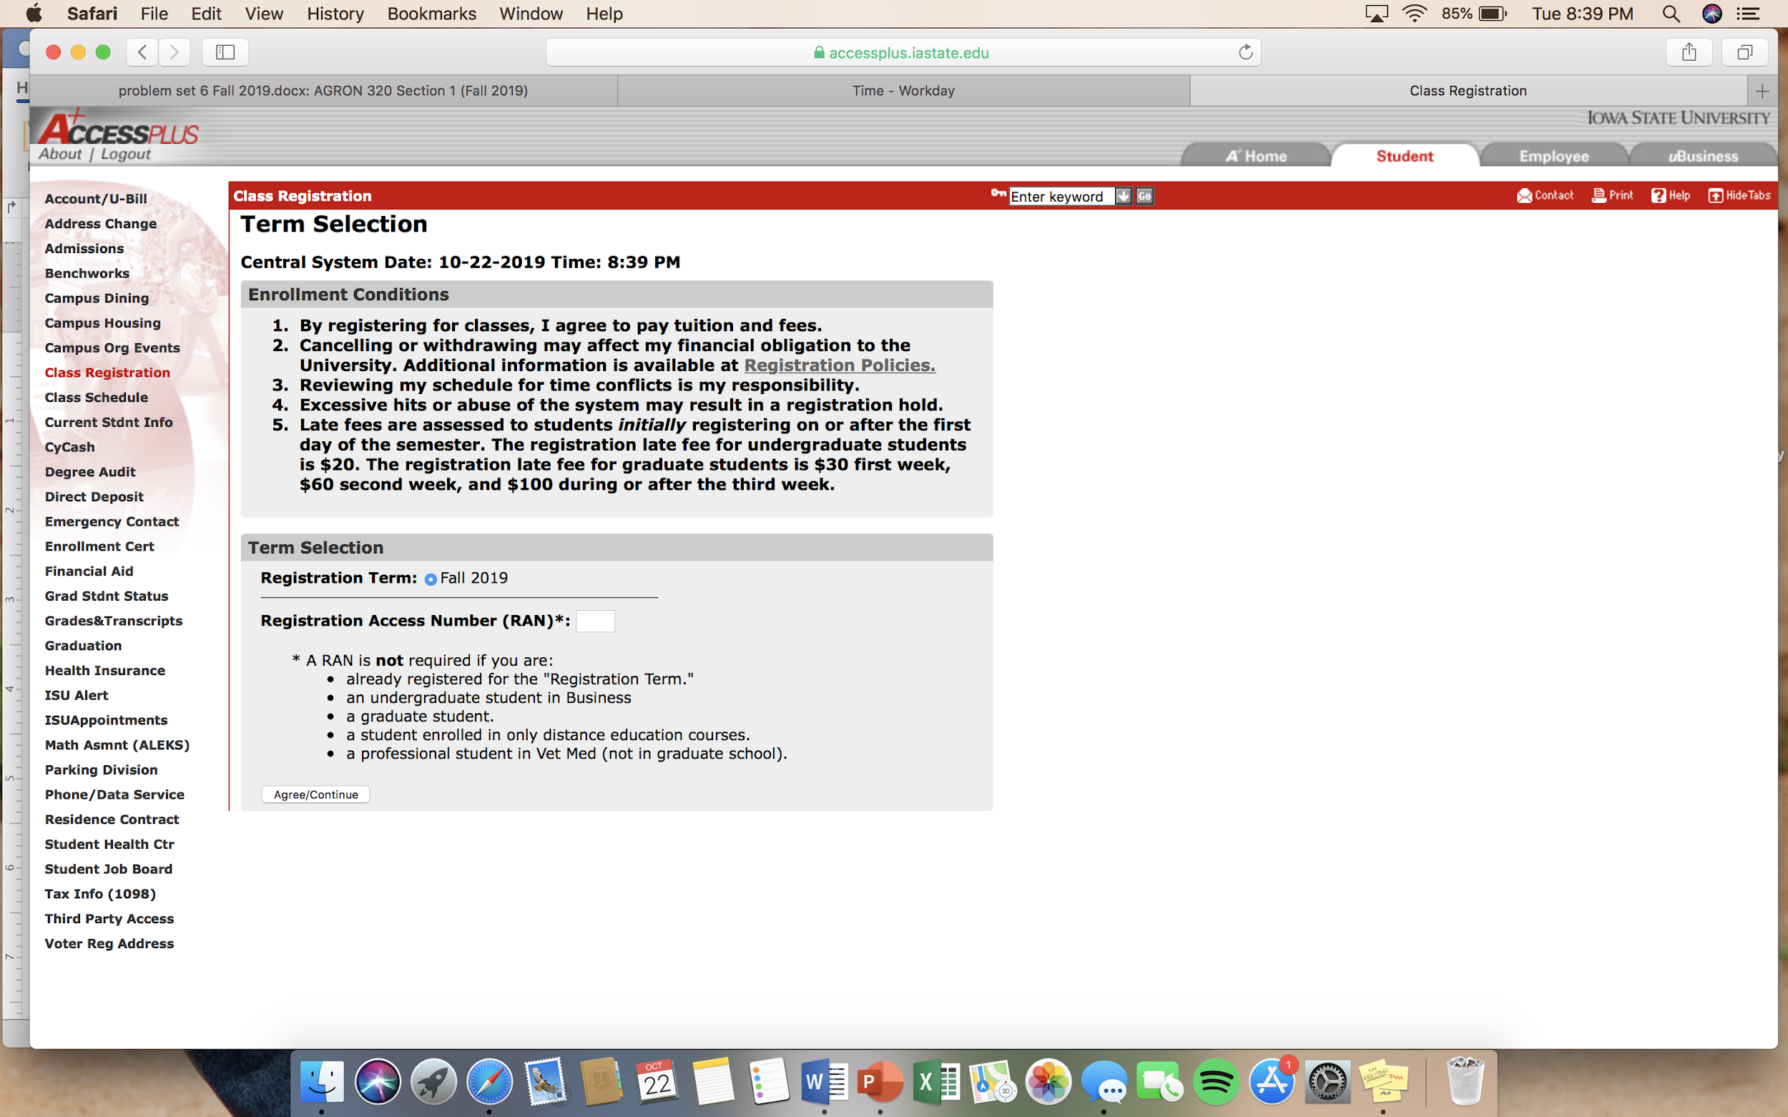
Enter your four digit RAN (from your adviser) then click on Agree/continue

Slide 12
How to create mock schedules:

Slide 13
Go to Iowa State homepage

Slide 14
Hover over students and click on schedule of classes

Slide 15
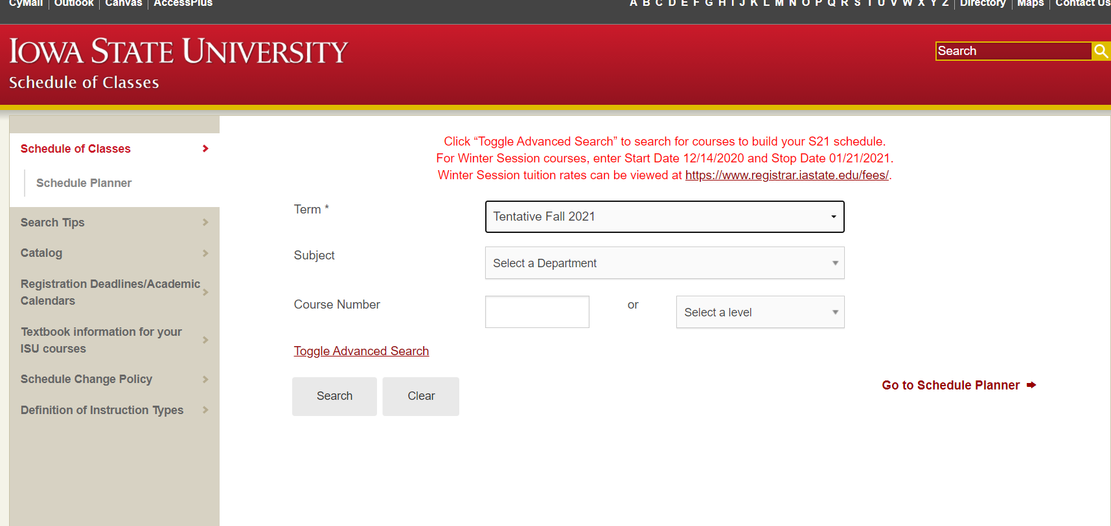
Make sure you select Fall 2021 and begin searching

Slide 16
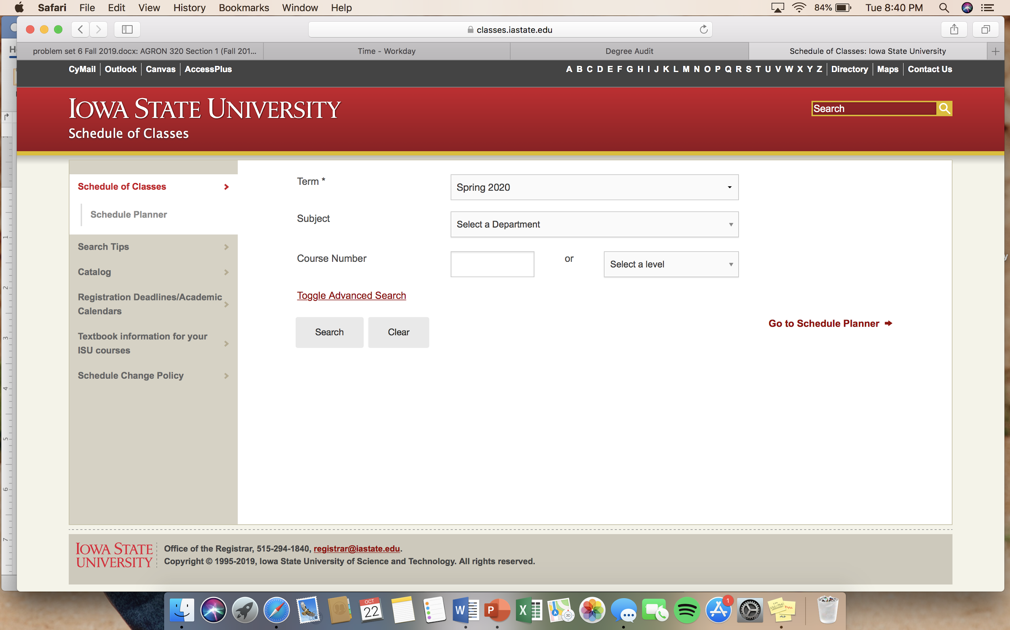
Once you find a class you want, add it to schedule planner

Slide 17
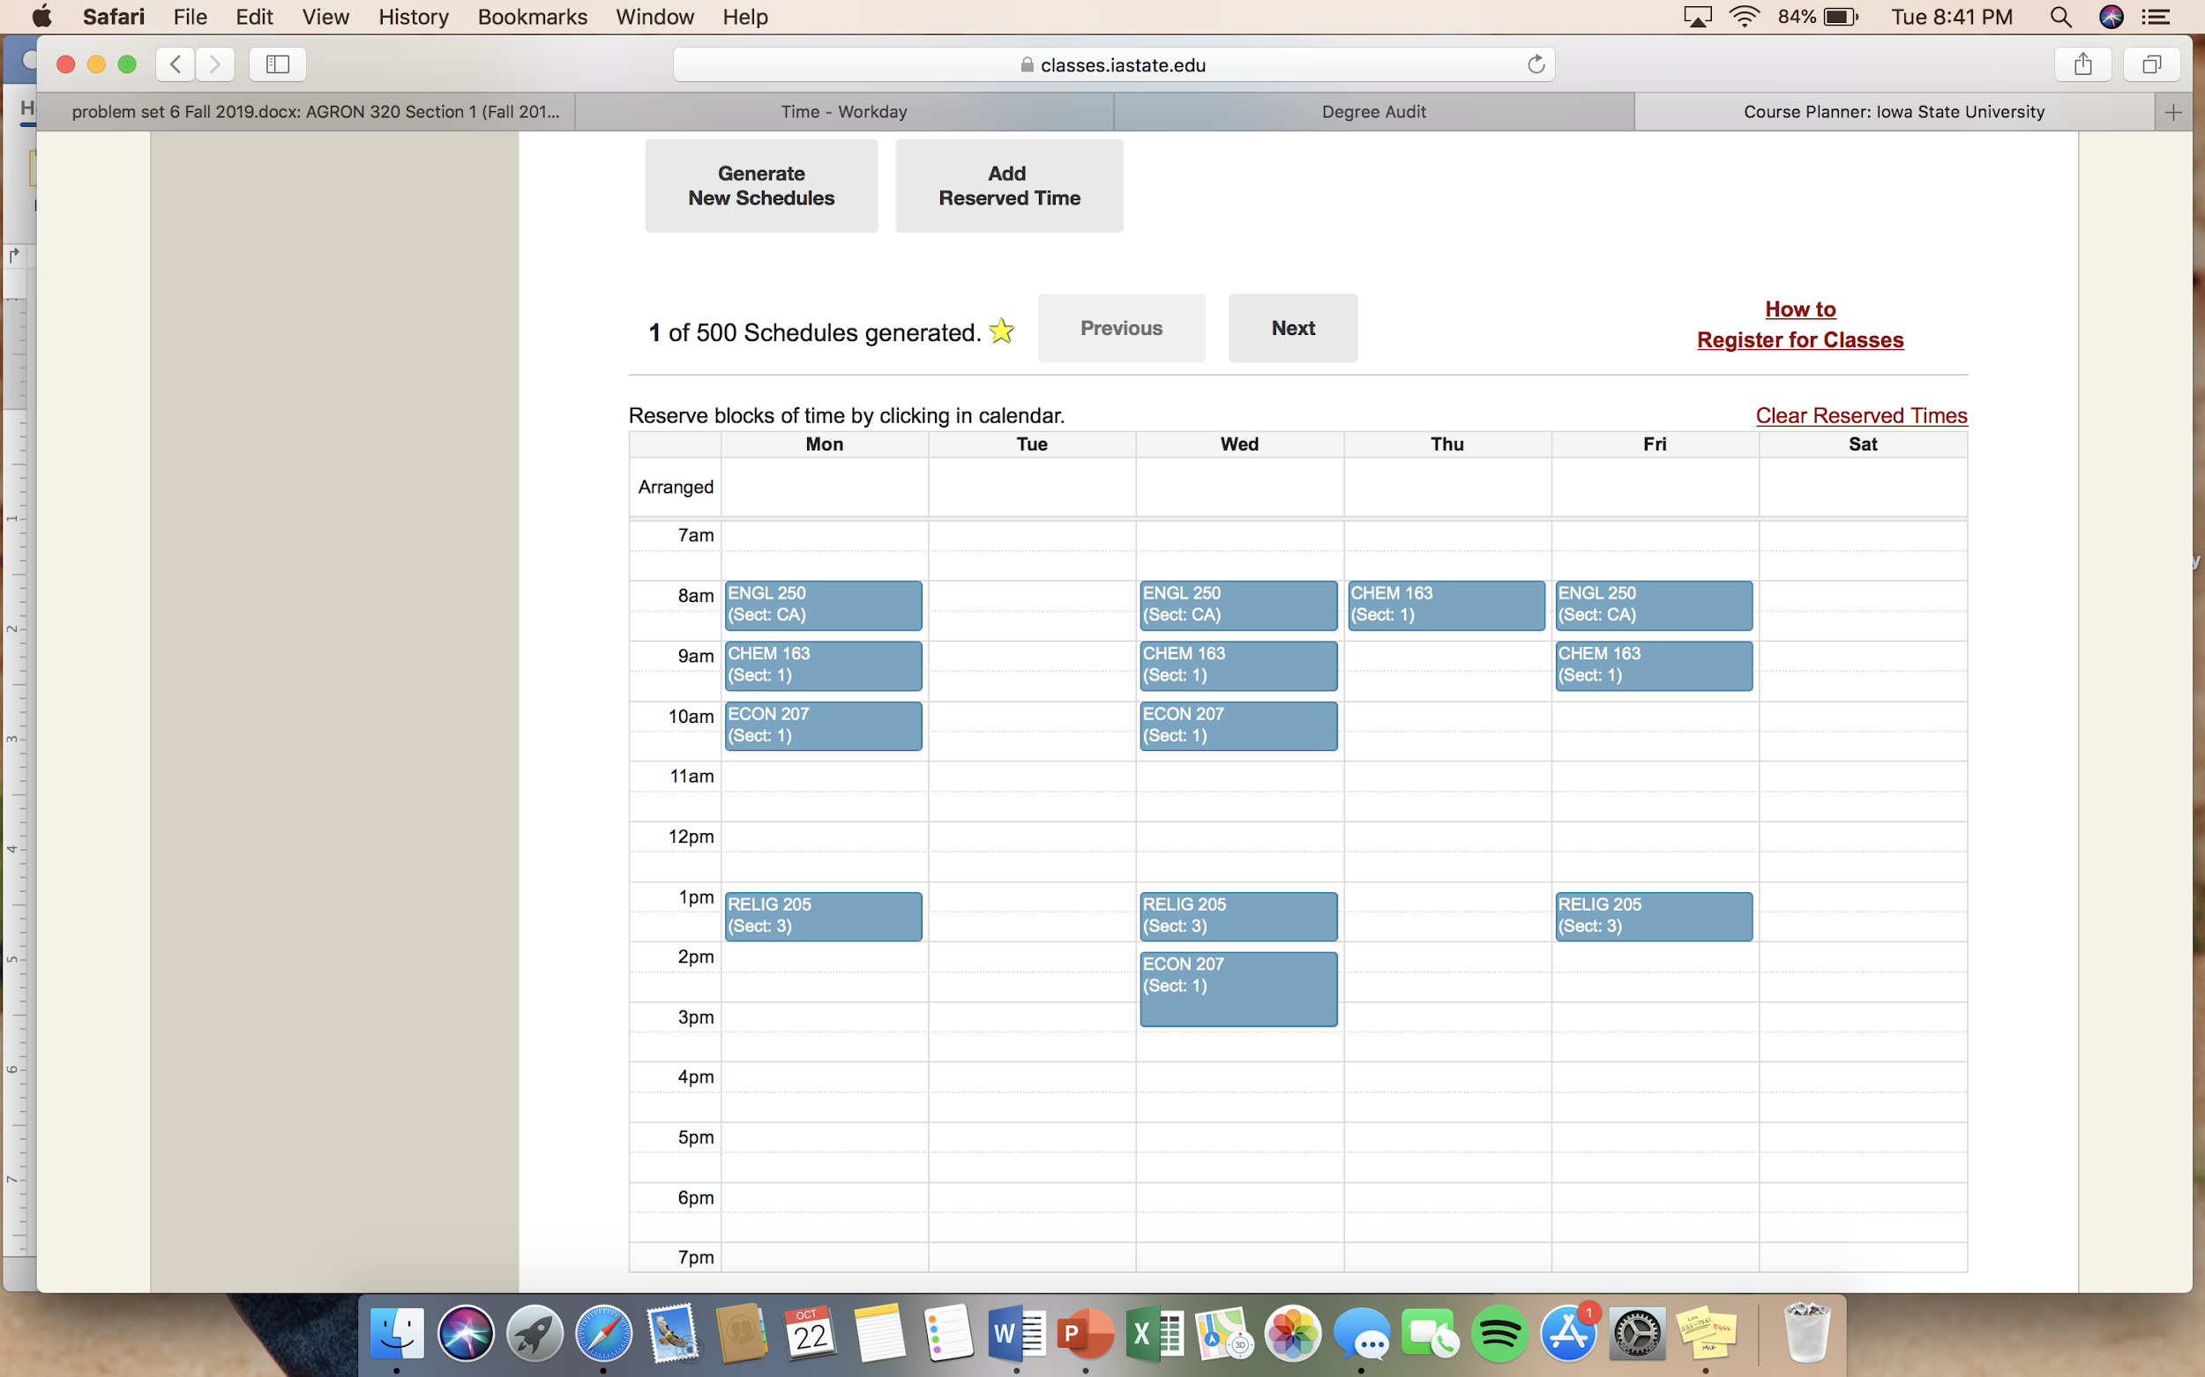
Then choose a schedule from ones generated

Slide 18
Take note of the sections and use those when registering

Slide 19
Econ Course Offerings
Econ 207 ** Econ 353 ** Econ 301 ** Econ 302 ** Econ 371
Econ 230 – Farm Bus Mgmt
Econ 234 – Small Bus Mgmt
Econ 236 – Ag Sales
Econ 313 – Econ of Sports
Econ 321 – Econ of Discrimination
Econ 330 – Adv Farm Bus Mgmt
??? Econ 332 – Cooperatives
Econ 334 – Entrep. In Ag
Econ 416 – Industrial Orgs
Econ 418 – Game Theory
Econ 431 - Managerial Econ
Econ 437 – Commodity Mkt & Risk Mgmt
Econ 466 – Ag Finance
Econ 480– Int. Environ. Resources
Econ 410X- Experimental Econ
Econ 460-Spring 2022
Notes:
313

Slide 20
Business Options Supply Chain Management Marketing Finance
Ag Business majors: to add a Business Option, please e-mail Amy (abrandau@iastate.edu). You must have completed the core courses.

Slide 21
Questions?

